Slide 1
the impact of fukushima on
nuclear Power
The new york association for energy economics
Chris gadomski, Lead analyst, nuclear
28 april 2011

Slide 2
contents
1. Impact of Fukushima
2. Challenges
3. Opportunities
4. Prognosis
Notes:
I want to focus on four aspects of the SMR Business Case today that will leave you with our assessment of the challenges and and opportunities that lie ahead.

Slide 3
On the record – post fukushima
“We’re seeing a knee-jerk reaction saying ‘get rid of nuclear,’ but that is not going to happen in the long run. There is no other good solution if you want to decarbonize the energy sector. As far as small reactors go, these events in Japan will strengthen their hand as opposed to weakening it.”
Chris Gadomski
Bloomberg Markets
May 2011
Notes:
I want to start this presentation with going on the record to state to you that I see a future for small modular reactors, though it may seem at times within the next 30 minutes that I do not.
I want to emphasize that I am here not as a cheer leader for the industry, but rather as an analyst paid to perform objective analysis of the sectors that I follow, which is nuclear.
New Energy Finace was founded by former McKenize consultants in London, and have offices in NY, Washington, San Francisco, Tokyo, Beijing, Australia, Delhi, South Africa, and Sao Paolo. Having been acquired by Bloomberg 14 months ago, we are now in the process of integrating ourselves into the other media outlets the company provides. I invite anyone to visit the nY office to get a sense of what we do, we are rapidly growing and a very aggressive company thatt, as I hope to prove to you, very data driven.

Slide 4

Countries considering nuclear
Nuclear countries
Considering nuclear
Source: Bloomberg New Energy Finance

Slide 5
New nuclear build – 65 reactors, 62.1GW

Slide 6
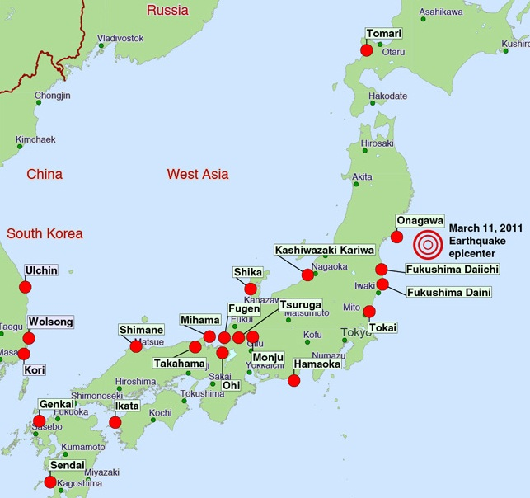
Nuclear reactors in Japan

Slide 7
pre-earthquake Planned total electricity supply by source, japan, 2009–19 (TWh)
60%
Source: Ministry of Economy, Trade and Industry, ‘Electricity Supply Plan of 2010’, 31 March 2010
Notes:
First of all, I would like to start with Fukushima. The impact is not to be casually ignored. The nuclear industry tends to be very inward looking. One of the advantages, that BNEF offers is that we have many analysts and journalists looking at very different markets and technologies and accordingly we can bring to you a less bias analysis –though that is often a very difficult thing to cull out.

Slide 8
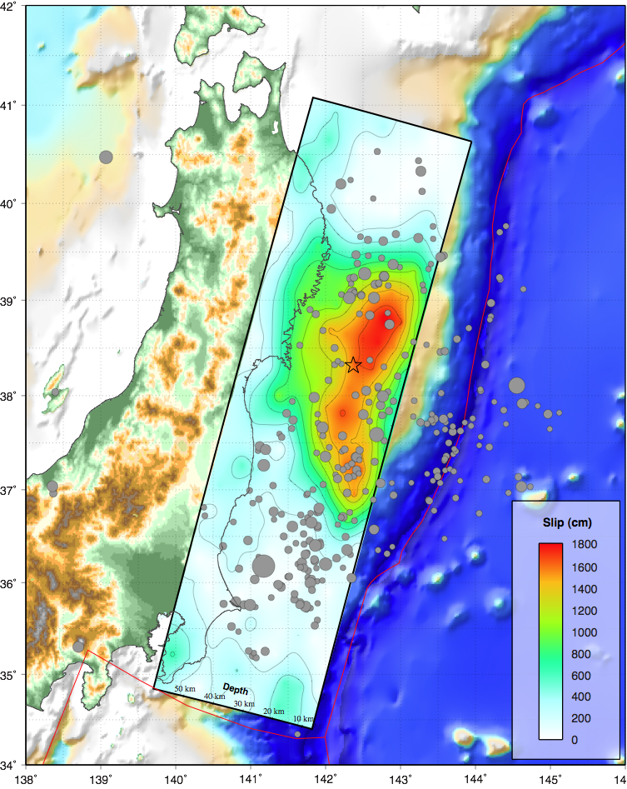
March 11th quake – handwriting on the wall?
Compact rupture, mostly bilateral about epicenter, peak slip up dip of hypocenter.
Rupture likely restricted to the shallow trench, and GPS vectors suggest slip did not reach the plate boundary.
In other words, why locate nuclear power plants nearby?

Slide 9
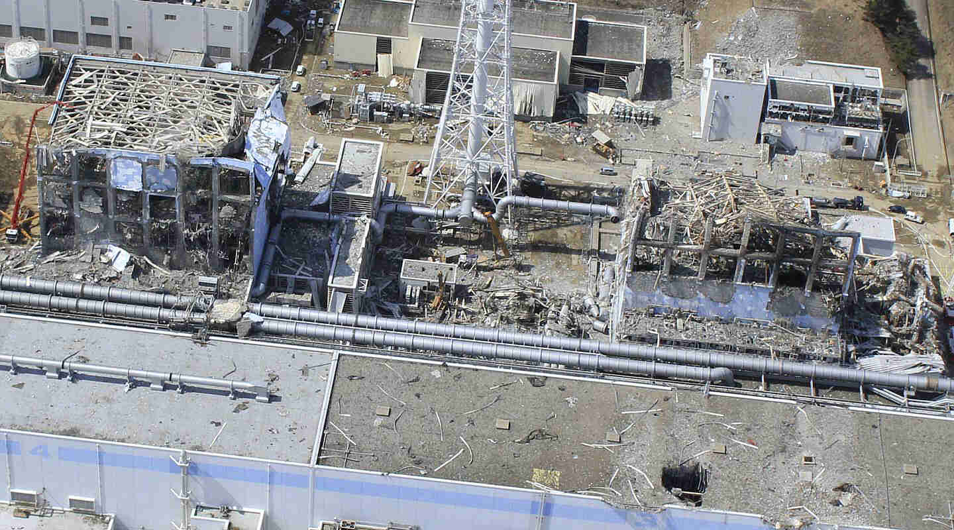
Fukushima Units 3 & 4, March 24, 2011

Slide 10
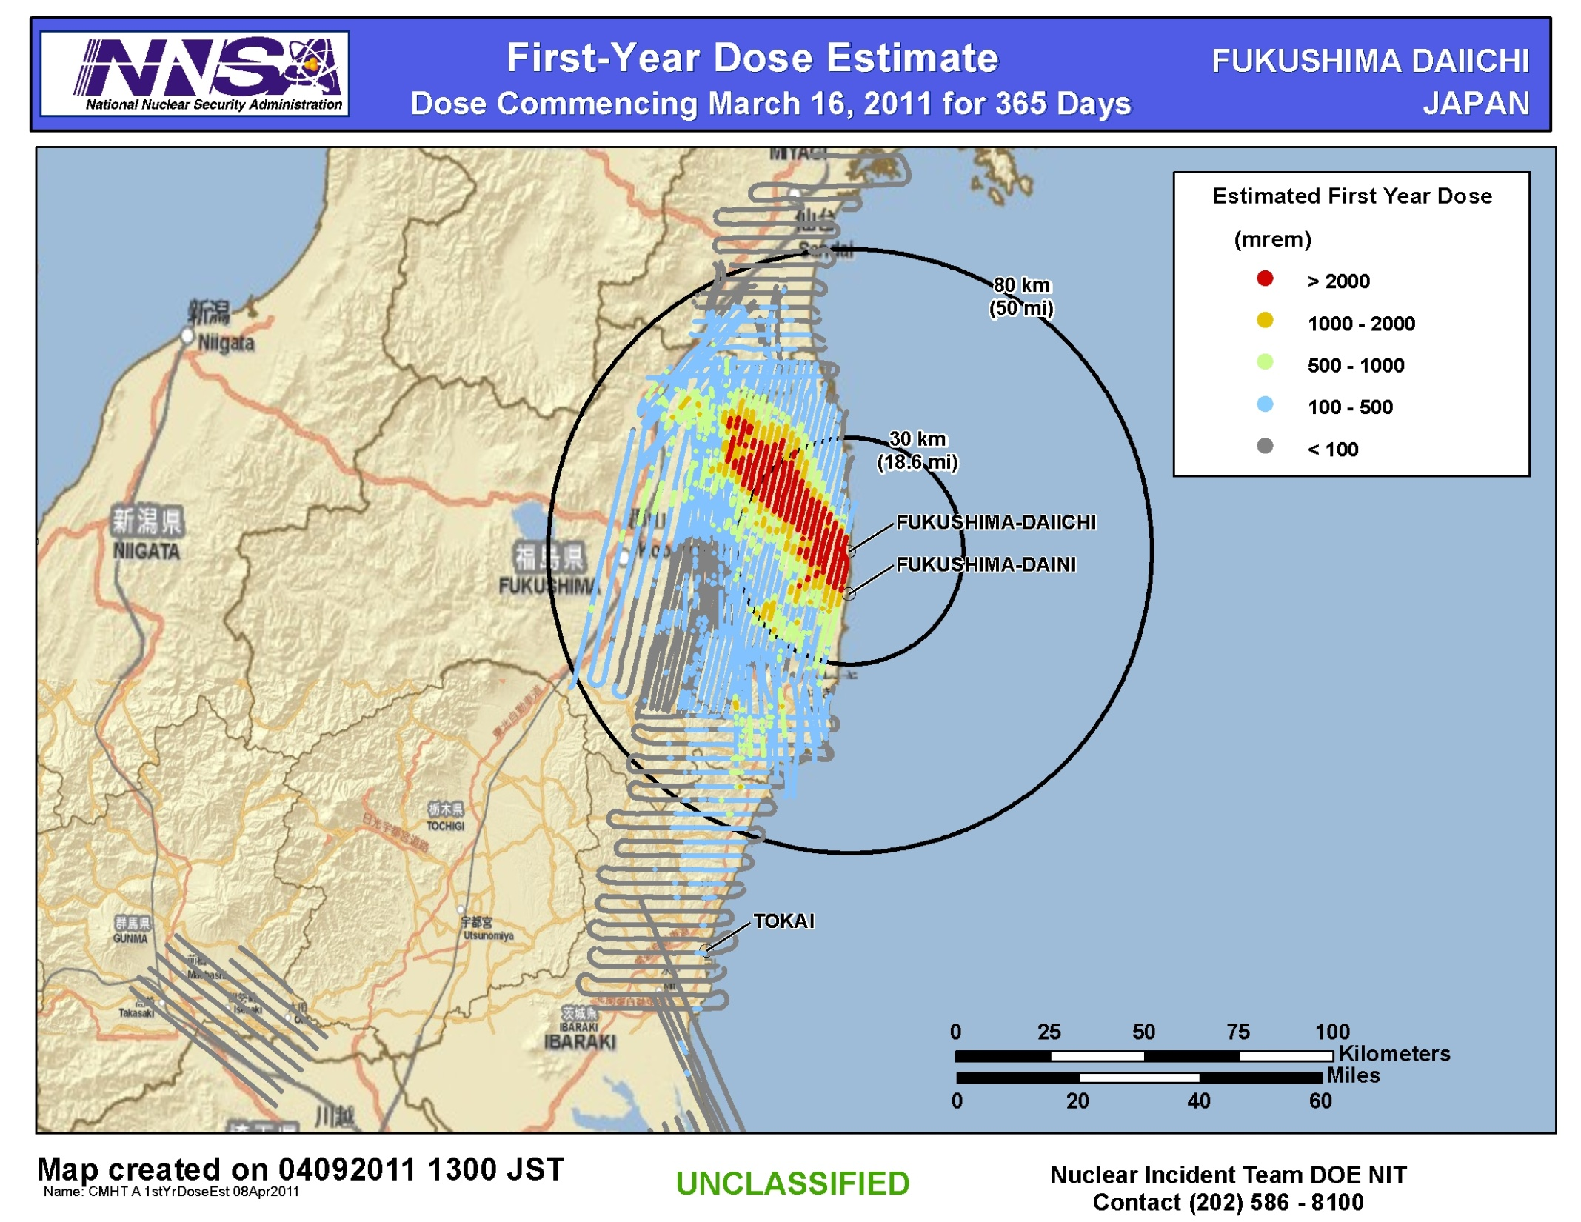
First year dose estimate
Source: DOE/
NNSA

Slide 11
Guide to interpretation
First-Year Dose Estimate commencing March 16, 2011:
Map shows the radiation dose that would be received by people in the first year following the release of radioactive material from the Fukushima Daiichi plant.
  First-Year 2 rem Threshold
    People who did not evacuate this area before the releases occurred would be expected to receive 2 rem or greater dose if they remain in that area for one year following the release. (Red area) Those that did evacuate the red area prior to 16 March would be expected to receive less than a 2 rem dose.
  First-Year 100 millirem Threshold
    People who did not evacuate this area before the releases occurred would be expected to receive 100 millirem or greater dose if they remain in that area for one year following the release. (Blue area.)
  Assumptions/Notes
  This dose estimate is conservative and assumes no dose reduction factor for spending time indoors.
  This dose estimate takes into account radioactive decay of the source material.
  This dose estimate includes the effects of external radiation due to material deposited on the ground and inhalation of re-suspended radioactive particles.
  Based on 10 fixed-wing aerial surveys, dose conversion factor (DCF) computed for each flight to account for decay
  Computed dose based on NRC-supplied radionuclide mix, consistent with results to date for nuclides that have been measured
Source: NNSA via DOE

Slide 12
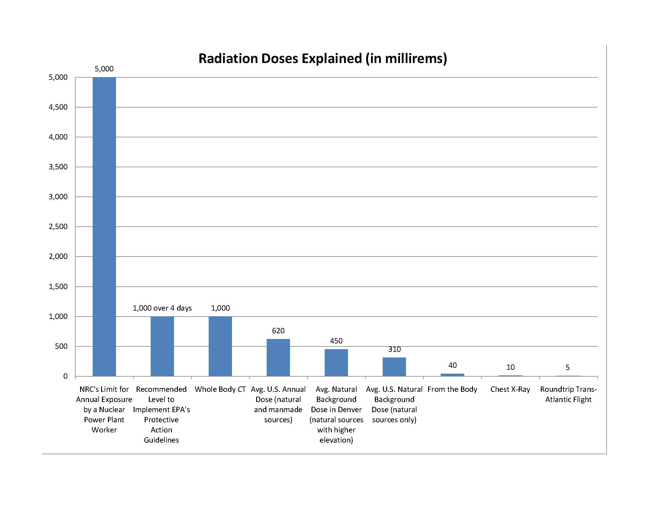
Guide to interpretation
Source: NNSA via DOE

Slide 13
Perceived risks post fukushima
Fukushima was a “made for TV” disaster...waiting for Godzilla.
  New regulations and additional safety requirements, especially if they require permissions from regulators or government bodies, may add to cost of new build.
  Risks associated with new build raises necessary rate of return (up to 15%???), compared to 12% for other facilities. Cost of debt climbs to 10% from 7%.
  Renewed social, political and environmental push-back against nuclear.
  - In the US, could this kill new build and current relicensing?
  - Opposition to new nuclear build abroad – does this have legs?
  Natural gas and renewable technologies are now more attractive technology options.
      - Will natural gas fracking become an issue?
Notes:
With all due respect and with all of my condolences to the suffering that went on at Fukushima, it was a made for TV disaster that could only have become more captivating had Godzilla re-emerged from the radioactive waters off of the site.
While one can argue that the technological impact of the event can be managed, going forward the nuclear energy industry should not ignore the psychological impact of Fukushima at. If it does so, it does at its own peril.

Slide 14
10 days after -- Impact of fukushima
90 to 180 days later how will this change?
17 countries staying the course
5 countries unclear
3 countries reversing course
Source: Bloomberg New Energy Finance
Notes:
Our global assessment one week after Fukushima that its impact on global nuclear markets was not severe with only three European markets-Germany, Sweden, and Switzerland getting a chill. 17 countries are staying the course, five are unclear.
There is one big caveat, however, that as the Fukushima problem continues to simmer, we anticipate that more countries will join the unclear category, and hence, become possible less attractive options for SMRs.

Slide 15
contents
1. Impact of Fukushima
2. Challenges
3. Opportunities
4. Prognosis

Slide 16
Challenges to US large reactor new build
High capex
Natural gas
competition
$11-17bn???
Near- to mid-term prices bearish.
Need $8, $11, $13 natural gas prices, says some US utilities.
Will declining prices for competing technologies change/delay utility strategies.
Carbon policy
Energy efficiency
Recession
No clear policy, looming EPA regulations.
Uncertain new demand for electricity.
Are we heading to a double dip?

Slide 17
NEW REACTOR BUILD PRESENTS FINANCIAL RISKS ($BN)
Equity value
$39.9
Enterprise value
$39.0
Illustrative ‘year spent’ cost of conventional 2,200MW twin unit AP1000 nuclear new build: $11.0–17.6bn
$34.4
$29.7
$27.2
$24.7
$22.2
$21.1
$20.8
$17.0
$16.4
$17.6
$16.7
$16.2
$12.9
$12.8
$12.4
$11.0
$11.3
$11.6
$7.6
$9.0
$9.4
$3.9
$4.1
$3.4
$4.3
$3.2
SO
EXC
D
DUK
FE
ETR
PGN
PPL
NRG
DTE
CEG
AEE
SCG
Source: JPMorgan; FactSet as of 13 March 2009, from NuScale
Notes:
If you are a utility planning an investment in a nuclear power plant, as all of these in the US are or were, the financial risk of investing in a large nuclear plant suddenly becomes a lot more daunting. The term “betting the company” comes from of the Ceo of the company’s characterized here in reference to the size of a nuclear investment compared to the equity value of the company making the bet. Pursuit of large nuclear investments have
Well I don’t want to speak for those utilities but I would say that it is a pretty big challenge for them. When they look at their total financial picture, loan guarantees are a significant issue that they are going to have to work through in order to be able to go forward with their new builds. Simply, loan guarantees are a “must” in order to be able to get the good financing that is needed to go ahead and build new nuclear plants. Is this going to undermine the opportunity to use traditional project finance structures to build new larege reactors?

Slide 18
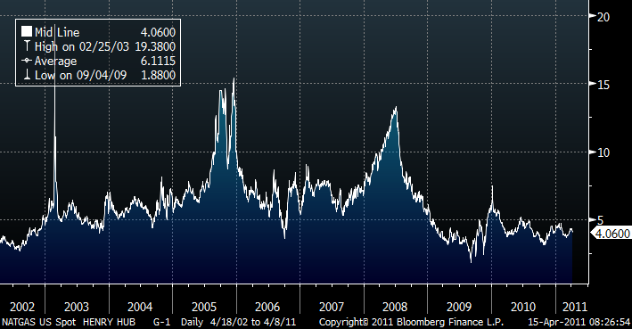
Low natural gas prices—near term sinking large nuclear…IS IT Also a threat to smrS?
Source: Bloomberg
Notes:
It is important to focus on this slide,which I believes suggestions one reason while the nuclear revival in this country is stalled. With the exception of just a few utilities, whom I believe are taking the appropriate long term 60-80 year view and are investing in new nuclear build, cheap natural gas has sank near tern new build plants, the question is whether it will also sink plans for SMRs and other renewable technology investments.
Would there not be many more representatives from the financial community here today if we were looking at $14 gas instead of $4 gas?

Slide 19
Global total New investment in clean energy
2004–10 ($bn)
Note: Includes corporate and government R&D, and small distributed capacity. Adjusted for re-invested equity. Does not include proceeds from acquisition transactions
Source: Bloomberg New Energy Finance
Notes:
While there is $400bn being invested in large nuclear across the globe,there is far less being invested in SMRs in this country. But there is a lot of money being invested in other clean energy investments, and this money continues to increase. The chief executive of American Electric Power said at the Bloomberg New Energy Finance summit in New York just two weeks ago, that as business we need to keep a close eye on the competition. We are all strong advocates of nuclear power in this room, at least most of us anyway, but we need to recognize that electricty is a commodity , and that there are other green ways to generate it that is attracting a lot of investment cpaital around the globe.

Slide 20
New financial investment in clean energy by region q1 2004–Q4 2010 ($bn)
Note: Excludes corporate and government R&D, and small distributed capacity. Not adjusted for re-invested equity
Source: Bloomberg New Energy Finance
Notes:
It has not been a straight line, but it is trending in the right direction. For everyone of you in this room who believes that nuclear is a necessary and vital technology, there are many more who believe that it is not. Let us not be Ostriches.

Slide 21
The PV module experience curve, 1976–2010 ($/W)
MW (log)
Notes: Inflation adjustment using US PPI, R2 of c-Si regression = 0.94, R2 of FSLR regression = 0.98
Source: Bloomberg New Energy Finance, FSLR filings
Notes:
Especially given that the billions of dollars invested in Europe and In China are driving the costs down of pv power. Solar rojects that are looking for financing in California are now in the 250 MW range. Please let us not close our eyes to this interest, even though it too may have many other challenges.

Slide 22
Forecast large pv project capital cost, 2010–20 ($/w)
Note: Based on historical experience curves for crystalline silicon modules and other components, and the prices in the mature German market. 2010 dollars. Assumes Bloomberg New Energy Finance short-term build forecasts to 2013, 20% new build growth after that.
Source: Bloomberg New Energy Finance
Notes:
The net result is that we forecast large pv projects to cost half of what they cost today 10 years from now. Can we say the same about SMRs?
22

Slide 23
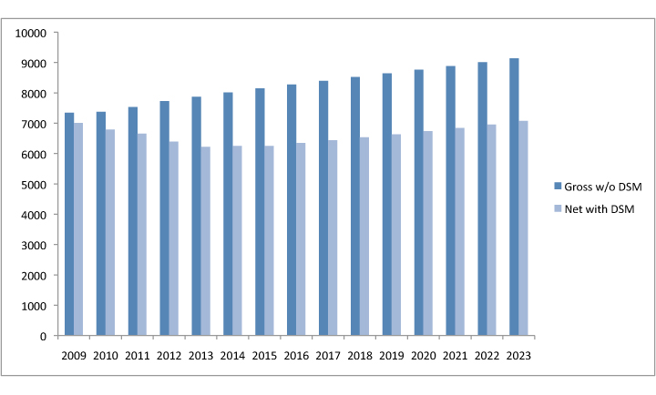
Baltimore Gas and Electric projected peak demand requirements (MW)
0%
(Demand-side management)
Source: BGE via Maryland DSM study
Notes:
There are projections every six months now that say gas will stay lower, longer and there is a threshold that creates that resistance to building new nuclear versus gas plants. And I think the phenomena there, as mentioned, is that load growth in a lot of utilities is down and if there is small industrial growth coming back, it is very slow and it is not one that the utility is anxious to bank on to make large capital decisions.
So everybody is kind of hoarding their cash or capital where-with-all in a way that creates their ability to recoup their earnings, monitor their own expenses and focus really on a short term view.
We have also had issues with banks unwilling to loan money they could loan. The government has tried to create an easing situation because there is such a general fear of where we were beyond where anyone thought we were going to be two years ago,
nd this is very much a tactical view and my concern is because of this two to five year slump, or whatever it ends up being, five to ten years from now the United States will be sitting back saying ‘I wish we could have realized that eventually we would have come out of this and gas prices won’t be $4.’ But that’s the gamble you take when you take a short term view.

Slide 24
contents
1. Impact of Fukushima
2. Challenges
3. Opportunities
4. Prognosis

Slide 25
Are small modular reactors an alternative?
Shorter deployment/construction time,
Interest for 3 vs. 5+ years, enables CWIP
Incremental build lowers initial capital investment,
$2–2.5bn vs. $11–17bn
Preserving corporate ratings,
Moody’s downgrades nuclear investors
Cash flow during construction, match supply to demand

Slide 26
SAMPLE LIFECYCLE ESTIMATE OF 540MW NUSCALE FACILITY
Major assumptions include:
  EPC price of $4,100/kw; 36-month construction schedule; owner cost of $50m for COLA but no additional owner costs
  60% debt financed at 8%/10.5% cost of equity for an investor-owned utility – IOU);
  100% debt at 5% tax free for a public utility
  Fuel cost of $5.50/MWh
  3% cost escalation
LIFECYCLE COST ($/MWH)
 | IOU financing |  | Public financing
 | 1st year | Levelised | 1st year | Levelised
Capital | 69.0 | 69.3 | 35.9 | 35.4
O&M | 14.4 | 18.9 | 13.9 | 21.5
Fuel (fuel and fuel waste costs) | 6.7 | 8.6 | 6.5 | 9.6
Other costs (interest income) | (0.0) | (0.6) | (0.0) | (0.9)
Decommissioning | 1.4 | 1.9 | 1.3 | 2.1
Total | 91.3 | 98.1 | 57.6 | 67.7
Source: NuScale
Notes:
For the small nuclear LCOE analysis we used company provided data as illustrated here.

Slide 27
Selected Smr Characteristics
Note: Capital cost/LCOE estimates provided to Bloomberg New Energy Finance
Source: Company reports
Notes:
Other leading global SMR efforts,, include the:
335 MWe IRIS PWR reactor being developed by Westinghouse in the US.
100 MWe KAERI PWR SMART design in Korea
35 and 295MWe PWRs being developed by Russia's OKBM Afrikantov, and
165, 210, 286MWe high temperature gas cooled reactors (HTR) being developed by PBMR (Pty) Ltd, in South Africa, by Tsinghua INET & Huaneg in China, and by General Atomics in the US.

Slide 28
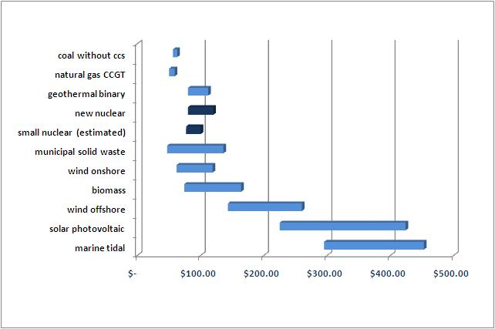
Bloomberg Levelised Cost of energy analysis does nuclear remain competitive?
Source: Bloomberg New Energy Finance, Industry estimates
Notes:
Several vendors have completed detailed engineering construction cost analysis that suggest small modular reactors will come to the market at an anticipated per kW of capacity cost estimated between $3700 to $5000. Some vendors who provided levelised cost of energy (LCOE) estimates suggest a range between $70 to $100/MWh. Those numbers place these reactors in a competitive position versus other renewable technologies as illustrated in Figure 2.
LCOE analysis of the selected generating technology was calculated on the Bloomberg terminal LCOE model using November 2010 data. Nuclear estimates have been provided by different vendors and other industry analysis. A distinguishing point is that the non nuclear generating costs are real figures representing typical Q4 2010 costs. Nuclear figures are best estimates of anticipated costs of projects coming online between 2018 and 2020. The comparison analysis, accordingly, does not reflect any expected price declines for specific renewable technologies like offshore wind and solar photovoltaics over the next decade.

Slide 29
Forecast China nuclear capacity (GW)
Build-out being reassessed
Source: Bloomberg New Energy Finance, WNA, Industry.
Notes:
India and China are growing 8 to 10 to 12 percent.

Slide 30
Forecast European nuclear capacity (GW)
Note: Includes Czech Republic, Finland, France, Germany, Holland, Hungary, Italy, Lithuania, Norway, Poland. Romania, Slovakia, Slovenia, Spain, Sweden, Switzerland and the UK.
Source: Bloomberg New Energy Finance, various sources.
Notes:
Eastern Europe where they are really focused in on energy security which has nothing to do with growth either. Countries like Ukraine and the Baltic States are really looking to try and get independent of Russian gas because they have been held hostage politically on that supply for several years. I think you will see the developing countries, for a number of reasons including energy security, really moving forward.

Slide 31
UK Generation Capacity (MW)
Source: Bloomberg New Energy Finance
Notes:
Under the current arrangements, it is difficult for nuclear to be built in the UK (it is difficult for even new CCGTs to be built in the UK at the moment). However, the Government is attempting to address this through its Electricity Market Reform. Four measures are proposed:
1) A carbon price floor (this is going ahead from 2013)
2) Emission performance standard which would ensure no new coal is built without CCS (doubtful this will go ahead as it is overkill on top of carbon floor)
3) A feed in tariff for low-carbon generation
4) Capacity payments
It is likely that the first and third measures will make building nuclear more attractive (capacity payments will probably only apply to demand response and peakers). We have done some research on the capacity payments mechanism but everyone is awaiting the White Paper to be release in June/July to see what the Government actually proposes (the consultation process closed in March).

Slide 32
UK Planned retirements
Capacity (mw)
Source: Bloomberg New Energy Finance

Slide 33
UK Planned retirements
Capacity (mw)
Source: Bloomberg New Energy Finance

Slide 34
Forecast US nuclear new build: is the renaissance delayed?
Revised projections
Source: Bloomberg New Energy Finance
Notes:
And then you have the more market driven energy industries and the U.S. and the U.K. are prototypes of that. And that is where we really see the impact of the recession and the strain in the financial markets having a big toll on the path forward that was charted around 2000 that was really centered on mega projects. Because the fact is that in a recessionary environment and in an area where you have the constrained capital markets, you just can’t get these projects off the ground in market driven economy and that’s why you see this whole issue with loan guarantees in the U.S. and everything kind of stalled out on the big reactor side.
Here in the United States we tend to suffer from a lack of definitive action on energy policy, climate change, and job creation. New nuclear plants can significantly help address these major issues facing our country. Building a new plant not only creates thousands of jobs during construction and hundreds of jobs during the life of the plant it also produces clean energy without greenhouse gases and reduce our dependence on fossil fuel. The key point here is there is dichotomy. Countries with smaller economies than the U.S. adopt long term energy policies and find ways to build new nuclear plants while we continue to look short term in the U.S., focus on upfront capital costs and act tactically, rather than strategically. Now is the time to take advantage of the great opportunity to create thousands of jobs and generate affordable, clean energy.
I still see us right now in the U.S. as not having all the real things in place that we need to make an aggressive new build program. We are still working a lot with our government trying to find ways to kick off and help the utility industry to want to invest this kind of money into new nuclear as well as all of us are improving our processes and fine tuning our pricing and supply chain so that we can accomplish this new build out when it happens. So we are still very bullish about it, but I still think we are still sitting in a two to five year slump here unless we find a way to somehow help the utilities to want to kick off projects here in the U.S.
The dynamics haven’t changed. You still have to justify any new build or any acquisition based on the financial aspect. At Entergy, we have to be prudent with respect to how we invest our capital. With natural gas prices being where they are and the long-term outlook of natural gas prices, it looks pretty bearish. And not having a really strong U.S. energy policy, even though the President has increased the loan guarantees, means that there are still a lot of issues up in the air. Another area where dynamic haven’t changed but must be resolved is with this long-term issue of used fuel. That is something that has become more of a political issue than it is a science issue. So I think until such time as we get all these things ironed out, the outlook is probably a bit bearish for us on new nuclear.
Ten nuclear power projects submitted Part II loan guarantees applications in December 2008, which represented $93.2bn in loan volume. Eight projects remain in various stages of due diligence including the Vogtle plant. Doe has requested an additional $36bn in the FY2011 budget.

Slide 35
New club member: Chile?
Installed capacity of 11.147GWs (2009)
60% of capacity burns imported fossil fuel
39% of power capacity is hydro, subject to draught
Power consumption to grow 17% from 58TWh in 2010 to 68TWh in 2014
Cost of energy remains highest in all of Latin America
Four unconnected grids spread throughout the country
Large mining demand for energy in the North
Obstacles
  High seismic activity
  Need for regulatory reform
Nuclear on the table…opportunity for SMRs?

Slide 36
contents
1. Impact of Fukushima
2. Challenges
3. Opportunities
4. Prognosis

Slide 37
Steep + W analysis
Social
Technological
Economic
What will be the social impact of any
technology pathway?
What are the most appropriate technologies
for individual markets?
Which technologies now
offer the greatest
economic
advantage/disadvantage?
Environmental
Political
Water
Which technologies,
policy directions, limit environmental consequences?
Can we develop a
consistent energy policy?
Is water the next big problem?

Slide 38
Steep + W analysis
Social
Technological
Economic
What will be the social impact of any
technology pathway?
Nuclear industry needs to counter Fukushima’s
psychological impact.
What are the most appropriate technologies
for individual markets?
Best technology may
not win.
Which technologies now
offer the greatest
economic
advantage/disadvantage?
Increased regulatory
burden for nuclear?
Gas more competitive, renewables gaining.
Environmental
Political
Water
Which technologies,
policy directions, limit environmental consequences?
Renewables now have a sharper edge...natural gas needs to deal w fracking.
Can we develop a
consistent energy policy?
Nuclear now a target. Competing technologies stepping up lobbying/
advertising.
Is water the next big problem?
BTA – What is best technology available for cooling water intake structures?

Slide 39
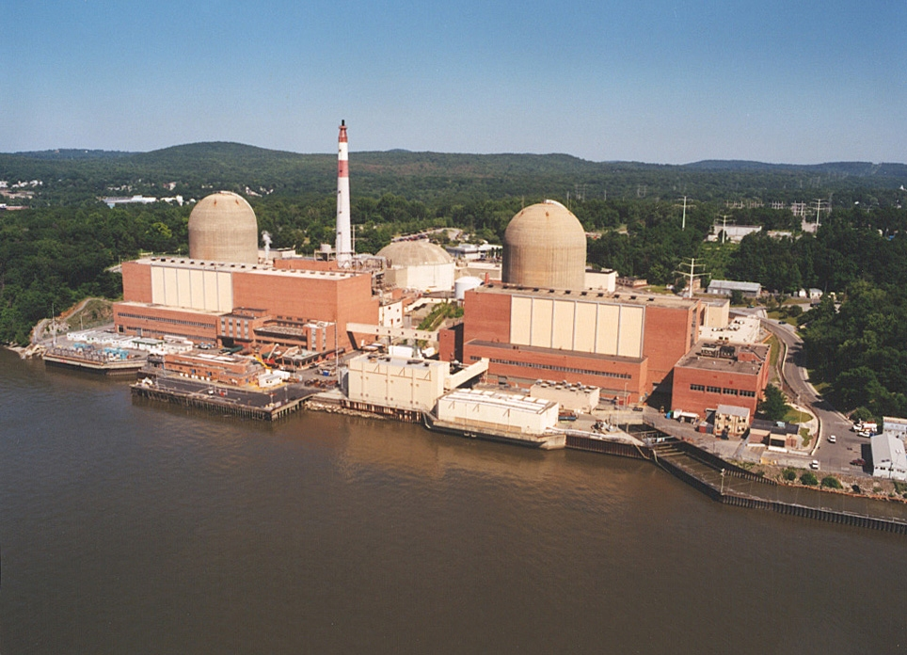
Indian point NPP – threat to new york?

Slide 40
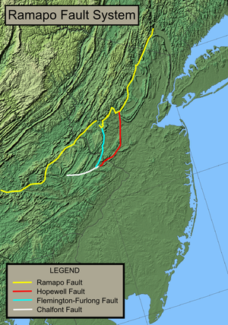
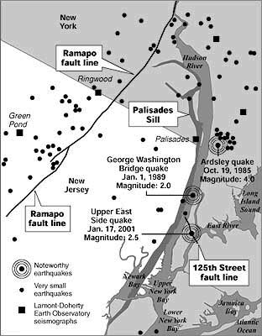
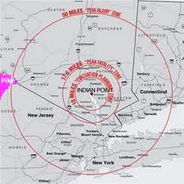
Indian point and the ramapo fault
A cause for concern or Fukushima hysteria?
Source: USGS, LOHUD

Slide 41
Looming environmental regulations
noX ract
Reasonably available control technology for oxides of nitrogen, in effect, compliance deadline July 2014, 9.5GW impact
bart
Best available retrofit technology for regional haze, in effect, compliance deadline January 2014, 8.9GW impact
mact
Maximum achievable control technology for HAPs (mercury), proposed ruling released in March 2011, 11GW impact
BTA
Best technology available for cooling water intake structures, NYS DEC reviewing comments, 4.4 to 7.3GW impact
Source: NYISO, Power Trends 2011

Slide 42
NY STATe energy Trends: Actual and Forecast
Source: NYISO, Power Trends 2011

Slide 43
The prognosis
Us market
First large US reactors come online 2016-18
How many smrs
IAEA:40–100 SMRs by 2030
Toshiba: 4,000 10MW units, $120bn
First to market
Russian floating reactors: 10 by 2020, $3.35bn
Post fukushima
Impact unclear, near term challenge from gas and renewables

Slide 44
Next steps – nuclear messaging
Highlight passive safety of new Gen 3 designs
Underscore seismic robustness
Address spent fuel disposal issues
Stress opportunities for local job creation
Emphasize the cost competitiveness of nuclear generated electricity
Position nuclear as a carbon-free complement to renewable technologies
Recognize that nuclear is not a panacea, but a very good solution to part of growing global energy and water challenges

Slide 45
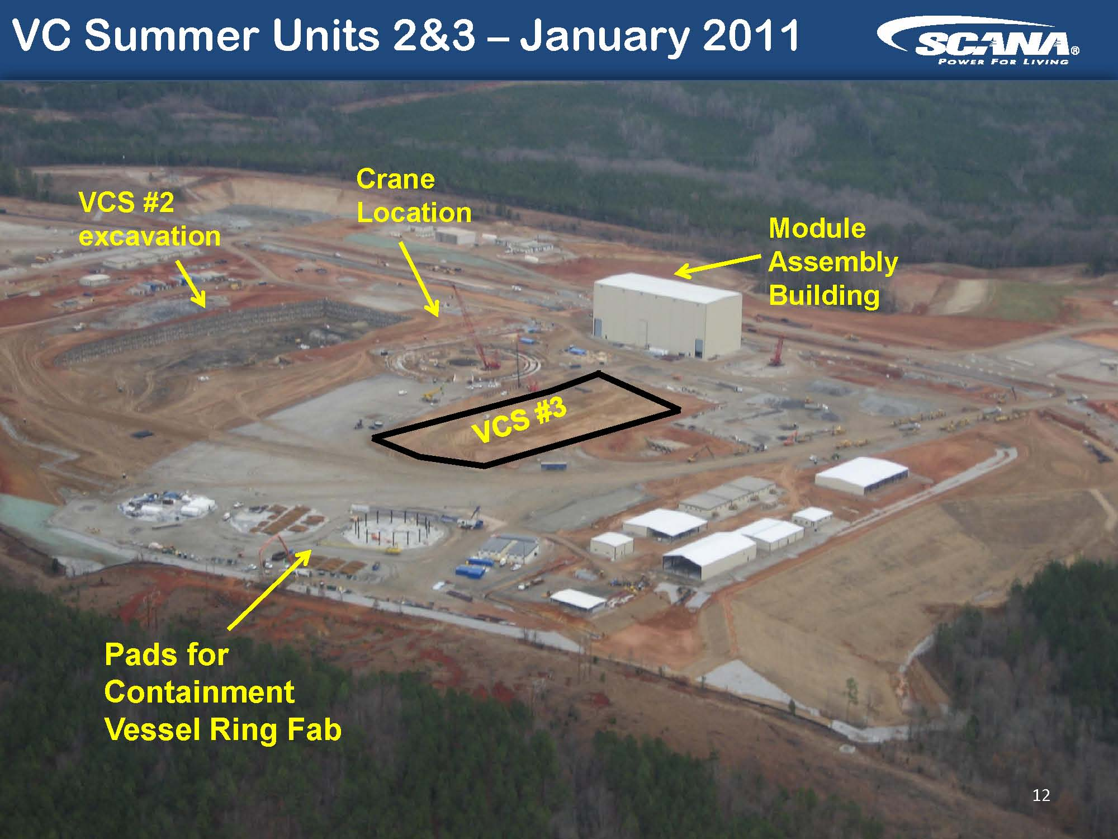
VC Summer 2&3 – no col yet…
Construction well underway
Source: SCANA

Slide 46
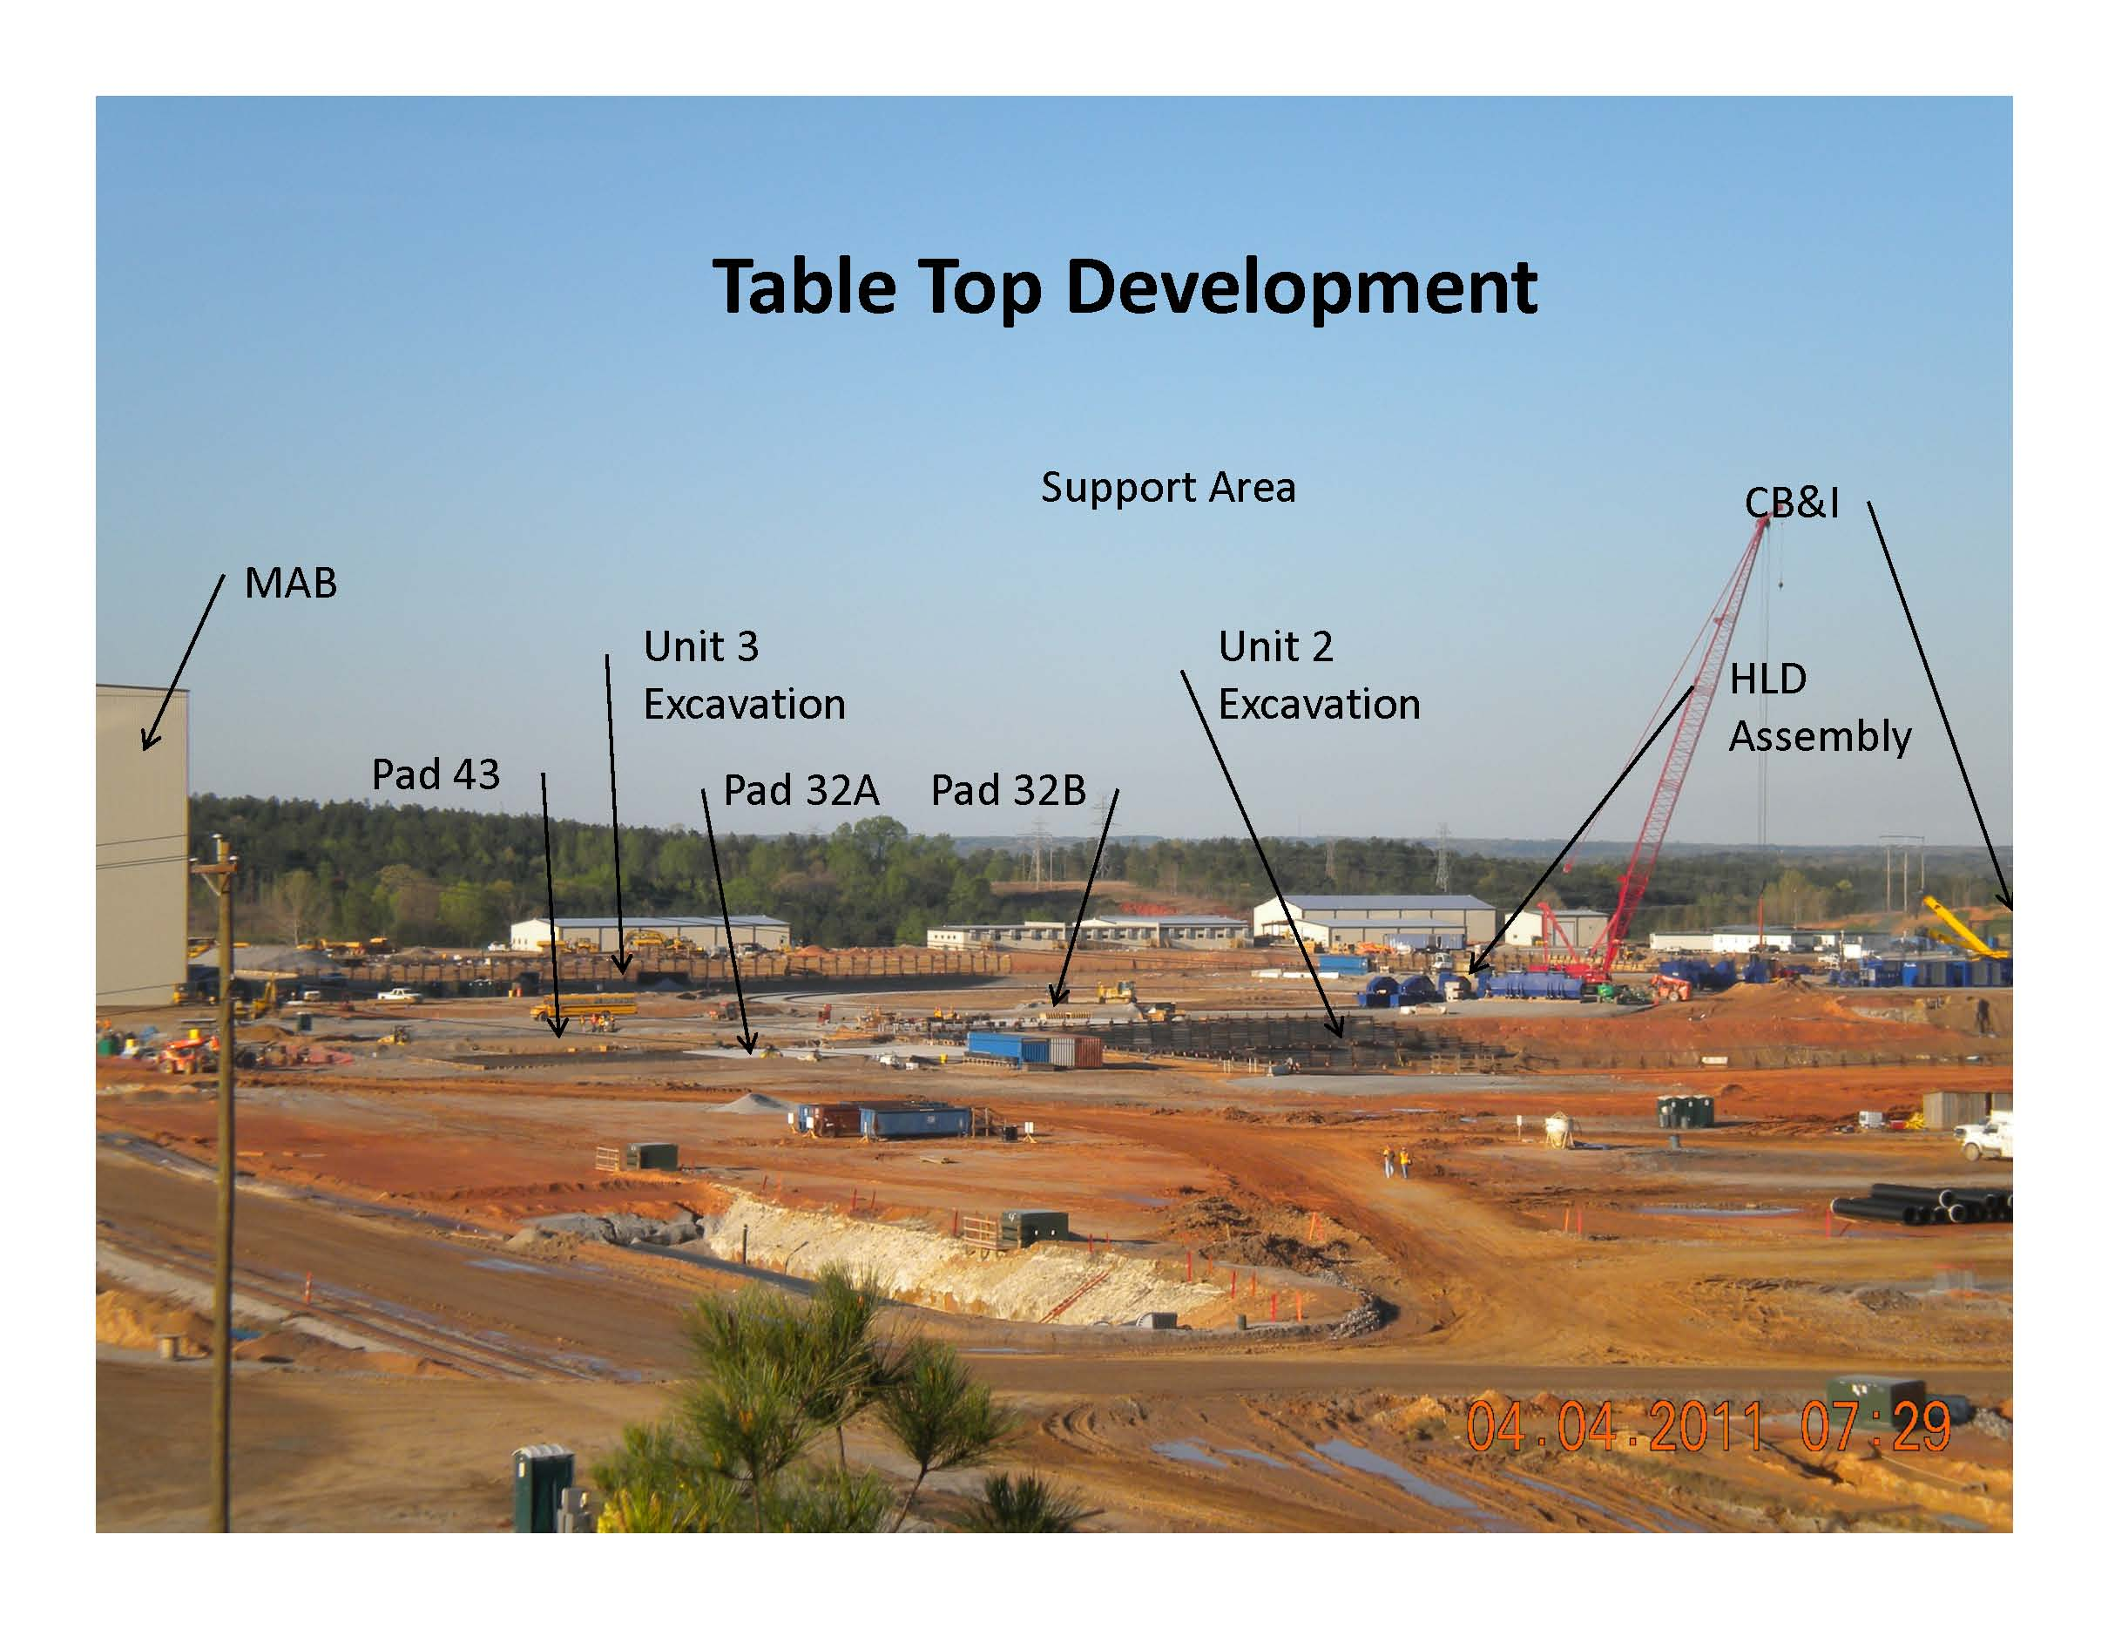
VC Summer 2&3 – no col yet… and under budget and on schedule
Westinghouse photo, April 4, 2011

Slide 47
On the record – post fukushima
“The US will build five new nuclear reactors by 2020 and ignore calls to scale back plans in the wake of Japan’s nuclear accident. We’ll see a reassessment and reevaluation…and then stay the course. Plans to build the five nuclear reactors are already underway and we don’t see that changing.”
Chris Gadomski
Bloomberg New Energy Finance Summit
April 4, 2011
Notes:
I want to start this presentation with going on the record to state to you that I see a future for small modular reactors, though it may seem at times within the next 30 minutes that I do not.
I want to emphasize that I am here not as a cheer leader for the industry, but rather as an analyst paid to perform objective analysis of the sectors that I follow, which is nuclear.
New Energy Finace was founded by former McKenize consultants in London, and have offices in NY, Washington, San Francisco, Tokyo, Beijing, Australia, Delhi, South Africa, and Sao Paolo. Having been acquired by Bloomberg 14 months ago, we are now in the process of integrating ourselves into the other media outlets the company provides. I invite anyone to visit the nY office to get a sense of what we do, we are rapidly growing and a very aggressive company thatt, as I hope to prove to you, very data driven.

Slide 48
COPYRIGHT AND DISCLAIMER
This publication is the copyright of Bloomberg New Energy Finance. No portion of this document may be photocopied, reproduced, scanned into an electronic system or transmitted, forwarded or distributed in any way without prior consent of Bloomberg New Energy Finance.
The information contained in this publication is derived from carefully selected public sources we believe are reasonable. We do not guarantee its accuracy or completeness and nothing in this document shall be construed to be a representation of such a guarantee. Any opinions expressed reflect the current judgment of the author of the relevant article or features, and does not necessarily reflect the opinion of Bloomberg New Energy Finance. The opinions presented are subject to change without notice. Bloomberg New Energy Finance accepts no responsibility for any liability arising from use of this document or its contents. Bloomberg New Energy Finance does not consider itself to undertake Regulated Activities as defined in Section 22 of the Financial Services and Markets Act 2000 and is not registered with the Financial Services Authority of the UK.

Slide 49
THE impact of fukushima on us nuclear power
Chris gadomski, cgadomski2@bloomberg.net

Slide 50
Desalination opportunities in mena
M3/capital/year
ESCWA: Economic And Social Commission For Western Asia
Source: ESCWA

Slide 51
Desalination opportunities in mena
M3/capital/year
ESCWA: Economic And Social Commission For Western Asia
Source: ESCWA
Notes:
The largest projected new desal ination opportunites 2011 -2015 lie in Saudi Arabia, UAE, Kuwait, Qatar and Oman representing an additional 10 million cubic meters of capacity a day.
In comparison, the top 5 desaliination countries in 2008—Saudi Arabia, UAE, USA, Spain and China –had an installed capacity of 35.5 million cubic meters a day.
Remember not only is there an opportunity for new nuclear desalination in these markets, there is an opportunity cost for using fossil fuels to desalinate water for domestic consumption. Accordingly, there isa potenitial retrofit opportunity as countries in the region switch could switch to avoid CO2 emissions and reallocate domestic consumption for export markets.
Kuwait electricity demand, according to the Kuwait National Nuclear Energy Committee, is forecast to grow 7% annually through 2030 pushing the demand for capacity from 11GWs in 2010 to 25GWs in 2030. Kuwait currently burns 12% of its daily oil production--300,000 barrels--for electricity generation. At current oil prices of $100 a barrel, this translates into $10.5 bn to $11bn of foregone revenues each year.
For manufacturers of SMRs, a threat also looms from large reactor vendors.

Slide 52
BNEF Assessment– cautious but promising
Units installed
Models differ widely
Markets now develop later than sooner
More granularity needed
Market assumptions change rapidly
Is it a $500bn market…or more?
Sources: Various industry sources interpreted by Bloomberg New Energy Finance
Notes:
In the US, optimistic time frames for "first power" new large reactors are 2017-2018 with the Southern Company-led Vogtle 3 & 4 and the SCANA Corporation's VC Summer 2 & 3 projects leading the way. Both are Westinghouse AP1000 projects. If applications for design certification for small reactors proceed in 2012, then optimistic time frames for "first power" for small modular reactors in the US may be realistic between 2018 and 2020. If true, then SMRs may appear on the US market shortly after the first of the four new AP1000s start generating power.
According to the International Atomic Energy Agency (IAEA) countries with small- and medium-sized electricity grids or limited energy demand growth, remote villages, towns and energy intensive industrial sites, rapidly developing and cash poor economies and merchant plants in liberalized electricity markets present significant market opportunities for SMRs. The IAEA has forecast 40-100 SMRs by 2030 with a potential upside of nearly 1000 reactors by 2040 to 2050. Our assessment suggests that this may be too conservative in the short term and too aggressive in the long term principally because we anticipate continuing price declines in the cost of other renewable technologies such as photovoltaics and storage devices which may erode some of the SMR market share at the far end of the forecast period.
Rosatom's first floating nuclear power plants may start generating electricity in 2012 and eventually ten may be deployed by the end of the decade--representing a $3.35bn market assuming an average price of $335m. Security and environmental concerns, however, may slow the market penetration of this technology beyond Russia despite the opportunity it provides for delivering robust amounts of electricity and desalinated water especially to rapidly developing ASEAN and MENA markets.
The team developing Argentina's CAREM 27MWe reactor is supposed to have a prototype operating by 2014-2015, but it is unclear how realistic this is given the long development time to date of the CAREM project. Perhaps more important, is how serious and eager are other potential customers in Latin American and Africa for this reactor.
Globally, different market drivers are at work with different project economics. Analysis by Toshiba, suggested that key market segments such as hydrogen production and desalination present the most robust opportunities followed by industrial power, distributed generation and military market segments. When initially pursuing the Galena project, Toshiba had forecast a market of 4,000 10MWe reactors. At $30m each, that represents a potential market of $120bn.
Vendor forecasts remain ‘business sensitive’, hence unavailable, but numbers forecast significantly exceed the IAEA forecasts. Agency/consultant/industry models differ widely and a more granular approach is needed to accurately assess the market, nevertheless, hundreds of billions of dollars is not an unreasonable projection.

