Slide 1
New York City’s East River
Roosevelt Island Tidal Energy (RITE) Project
Leading the Commercialization of Hydrokinetic Tidal Energy Systems
Ron Smith
New York Association for Energy Economics
March 22, 2012

Slide 2
Marine & Hydrokinetic (MHK) Systems
Roadmaps To Commercialization
Ocean Renewable Energy Coalition (OREC); US Marine and Hydrokinetic Renewable Energy Roadmap- October 2011.
MHK technologies represent the potential to provide up to ten percent of US
electricity consumption
REF: http://www.oceanrenewable.com/roadmap
The International Energy Agency's Ocean Energy Systems (OES) International Vision for Ocean Energy
The 3rd Phase SuperGen Marine Energy Research Consortium (UK)
Charting the Course: Canada’s Marine Renewable Energy Technology Roadmap; Ocean Renewable Energy Group (OREG); October 2011
The ORECCA Offshore Renewable Energy Roadmap (EU); and
The Chilean Energy Ministry and the British Embassy in Chile recently commissioned a marine energy strategy for Chile.

Slide 3
MHK Power Potential
Worldwide Theoretical Potential – 270GW at 30% Capacity Factor
REF: International Energy Agency-Ocean Energy Systems (OES); website at
www.iea-oceans.org
Canada – Tidal-current – 6,300MW; River-current – 2,000MW
REF: Ocean Renewable Energy Group (Canadian MHK Trade Association)
http://www.oreg.ca
United States – 50.8GW – East Coast- 2,400MW; West Coast, Alaska, Hawaii – 48.4GW
REF: Assessment of Energy Production Potential from Tidal Streams in the United States,
US Department of Energy, 2011

Slide 4
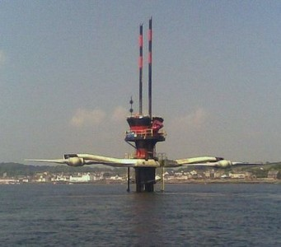
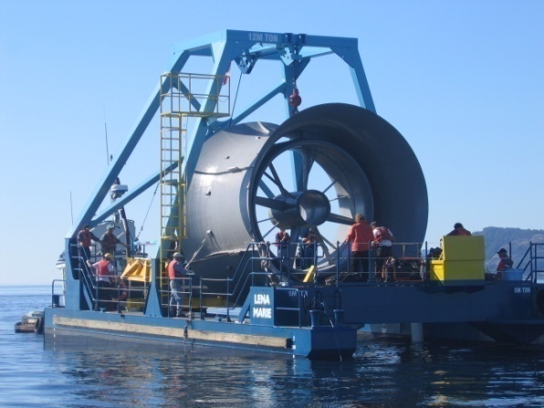
Tidal/Ocean Energy Devices
Most (> 40-50m depths)
  Marine Current Turbines
  Open Hydro
  Clean Current / Alstom
  Atlantis Resources
Verdant Power (< 40-50m depths)
  Greater application - sited near power needs
  Closer to shore or onshore - lower O&M, less transmission costs, if any
  Uniquely & easily scaled, fewer moving parts
  Higher efficiency & capacity factor
  Market leader - proven technology

Slide 5
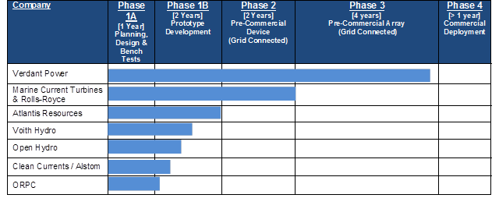
SEAI (Sustainable Energy Authority Ireland)
“10 Years from Prototype to Commercialization”

Slide 6
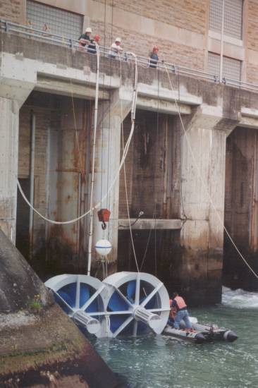
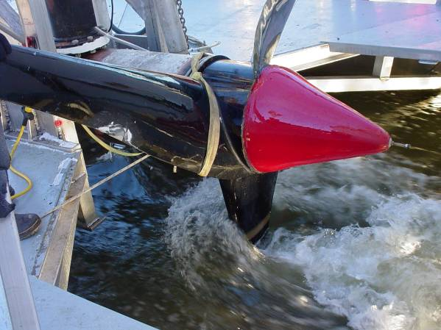
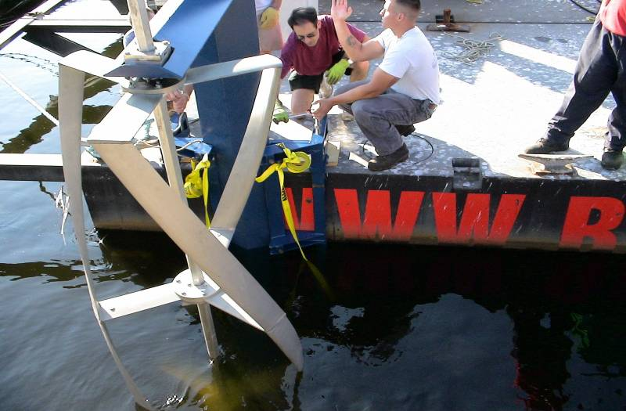
EPRI (Electric Power Research Institute)
“10 Years from Prototype to Commercialization”
Experience - Variety of Technologies
Built & Field-tested
Three Different Prototypes
  Dual-ducted Horizontal Axis
  Ontario Power Generation
  Vertical Axis (Triple Helical)
Massachusetts State
  Unducted Horizontal Axis
  New York Power Authority (NYPA)
Installed & Operated 17 Turbines
Commercial Standard System
  Fifth Generation (Gen5) System
  Work Validated by U.S. DOE
  Design Initiated by NYU & NYPA

Slide 7
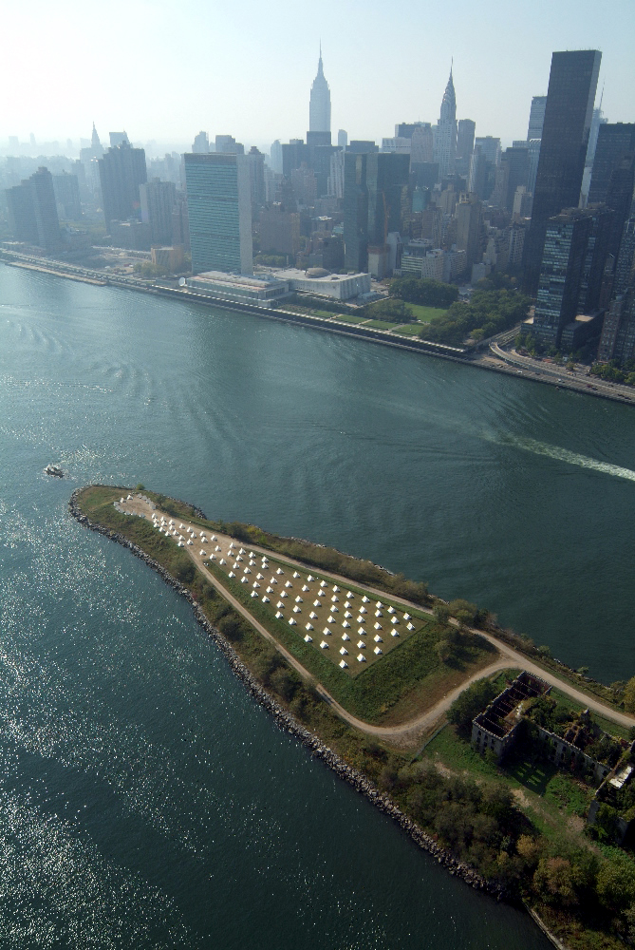



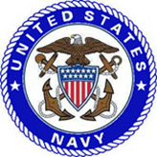






New York City & the East River
Roosevelt Island Tidal Energy (RITE) Project
Partners & Customers

Slide 8
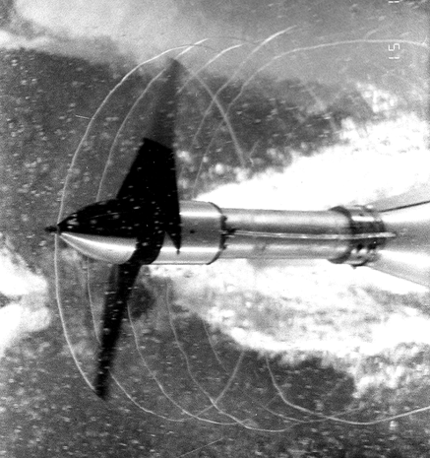
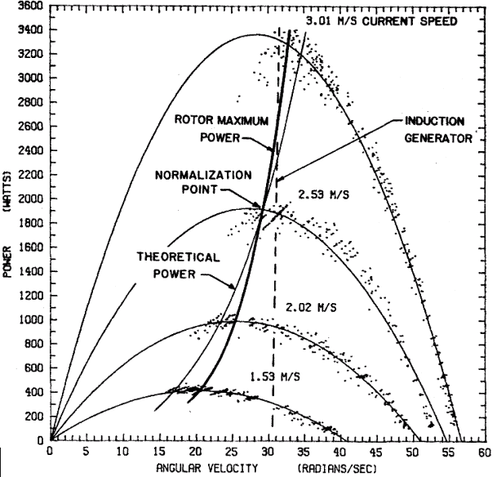
New York Power Authority & New York University Prototype Design & Bench Tests (1981-85)
Theory
Practical Economics
Blade Design
Rotor Dynamometry (U.S. Navy Lab)
NYU Prototype Turbine
  4.5-m Diameter Rotor
  Pakistan’s Bong Canal

Slide 9
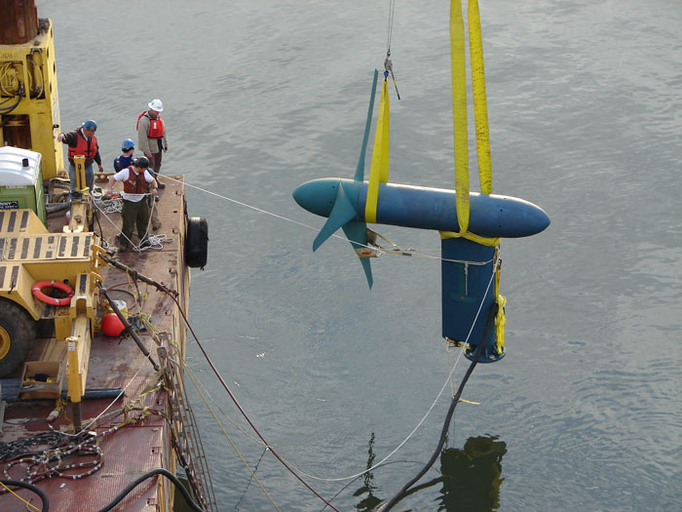
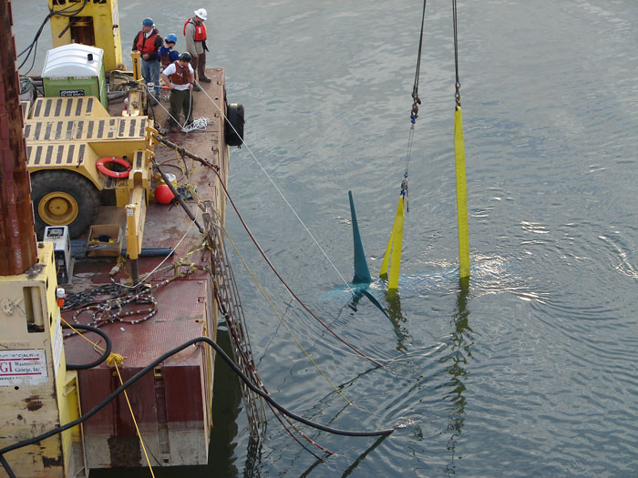
RITE Demo Project
Six Mounted Bottom Units
12/2006 to 8/2009
Pre-commercial Units (Gen4)
  Power to Two Customers
    Gristedes
    R.I. Motorgate
Generator Units (5)
  60+ MWh Energy Produced
  7,000+ Operational Hours
  Excellent Water-Wire Efficiency (~35%)
  High Capacity Factor (~30%)
Dynamometer Unit (1)
7
Notes:
My Apt: ~30 kWh per month. 1 kWh per day
Turbine: ~250 kWh per day (TIDAL)
60 MWh = 60,000 kWh = 2000 JC Apartment months = 165 JC Apartment years

Slide 10
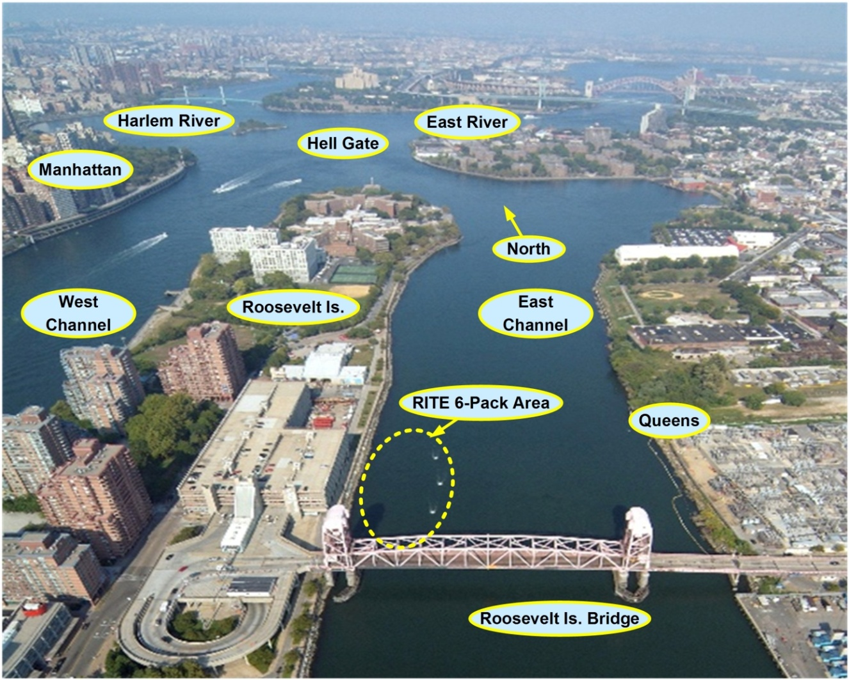
RITE Project - Phase 2
NYC’s East River, Grid-connected Array

Slide 11
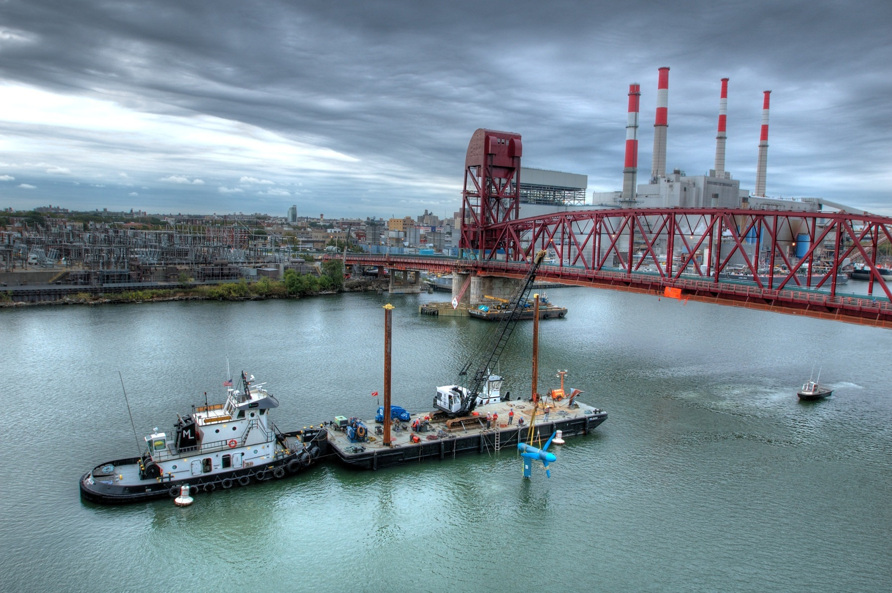
RITE Demo Project
Deployment
5

Slide 12
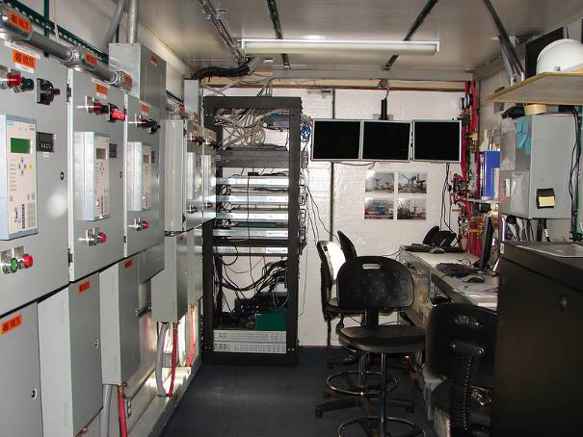
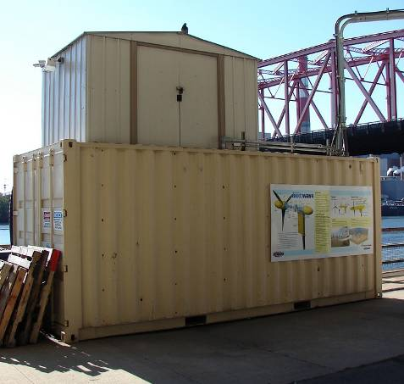
RITE Project - Phase 2
Control Room

Slide 13
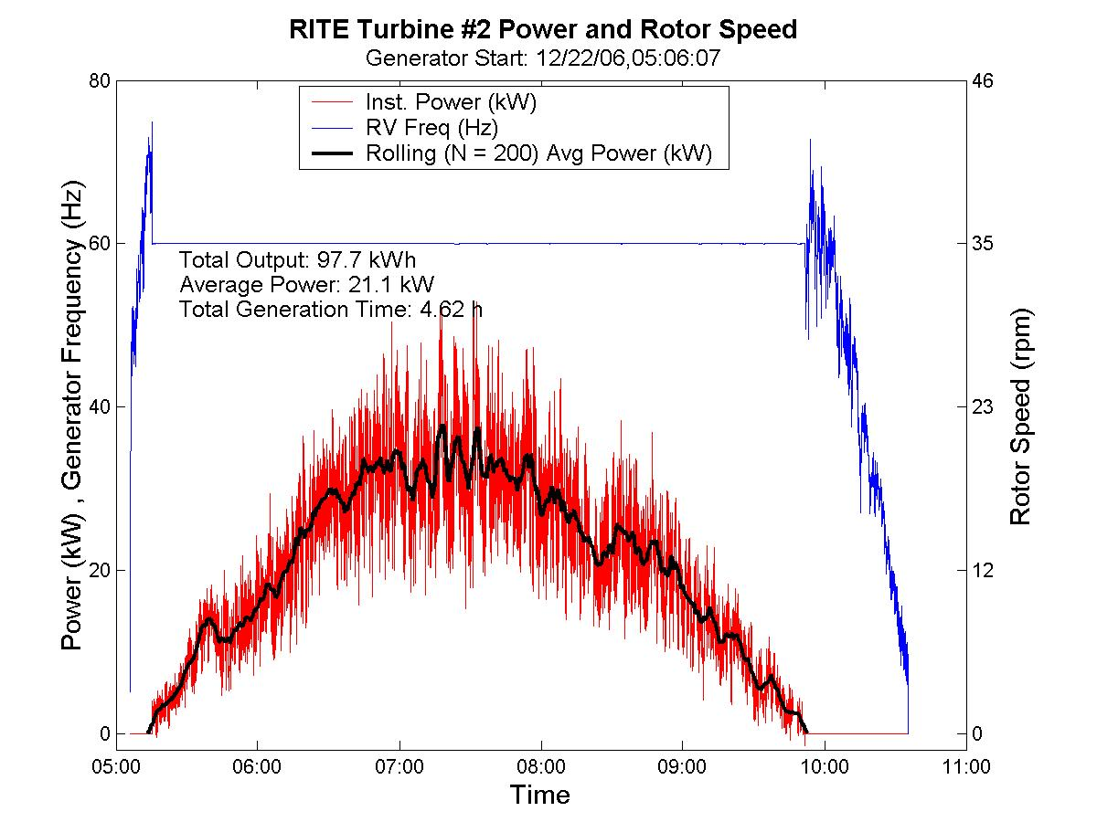
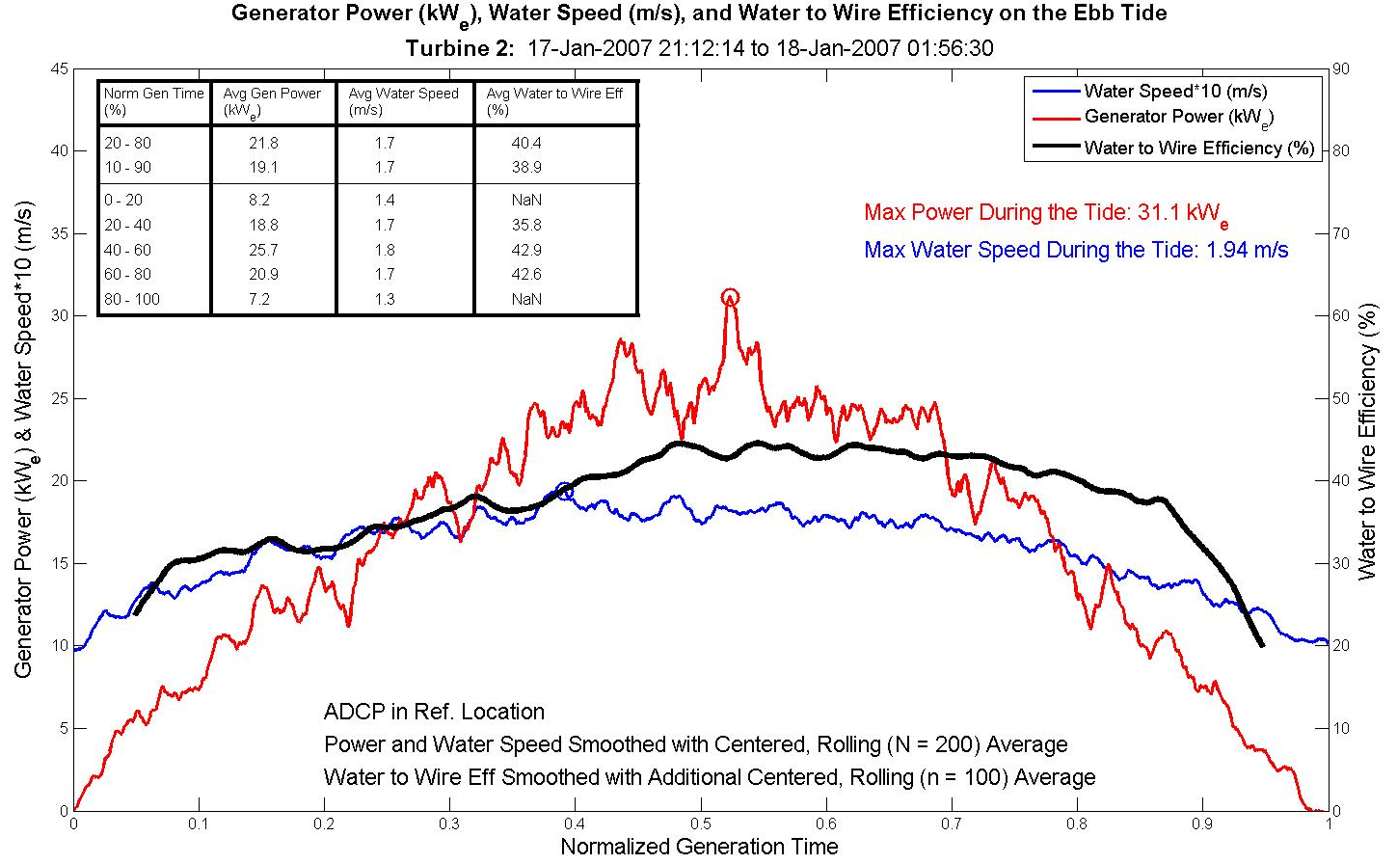
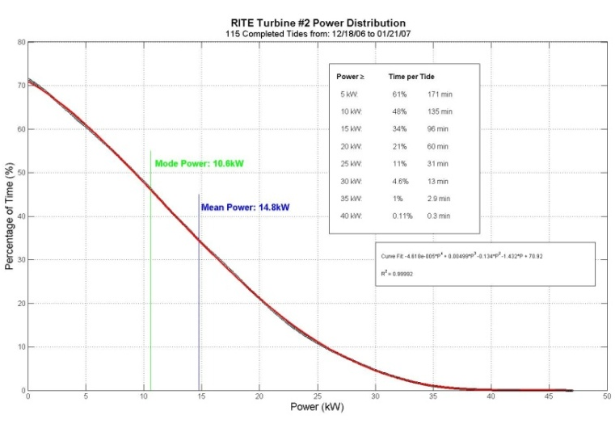
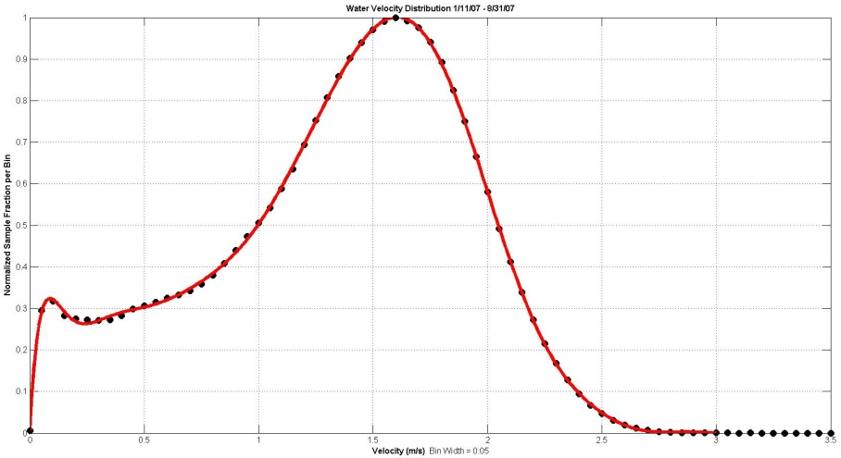
RITE Project - Phase 2
Power Generation

Slide 14
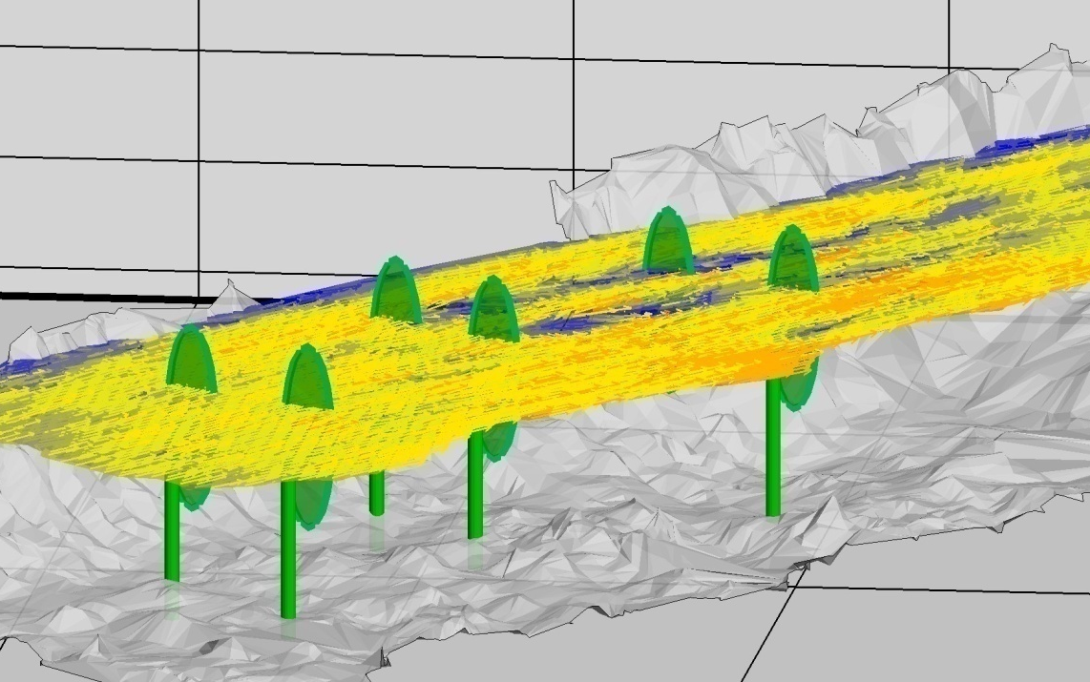
RITE Project - Phase 2
“Six-Pack” Array Flow

Slide 15
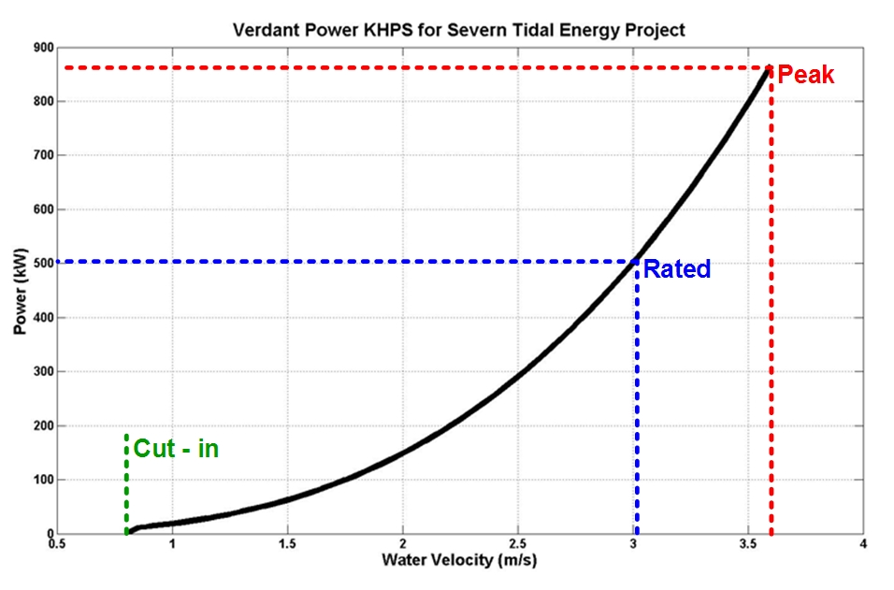
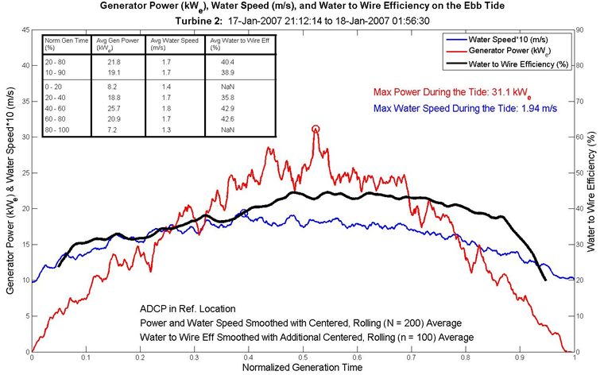
RITE Project - Phase 2
Results & Accomplishments
A Multi-turbine Array Installed, Reinstalled & Operated
Grid-connected, Power to End-users
Fully Bidirectional Tidal Operation
Fully Continuous, Automatic, Unattended Generation
Operation More than 9,000 Turbine-hours
Water-to-wire Efficiencies: 33 - 41%
Generated Power 77% of the Time
Capacity Factor ≥ 30%
Generated over 80 MWh into NYC grid

Slide 16
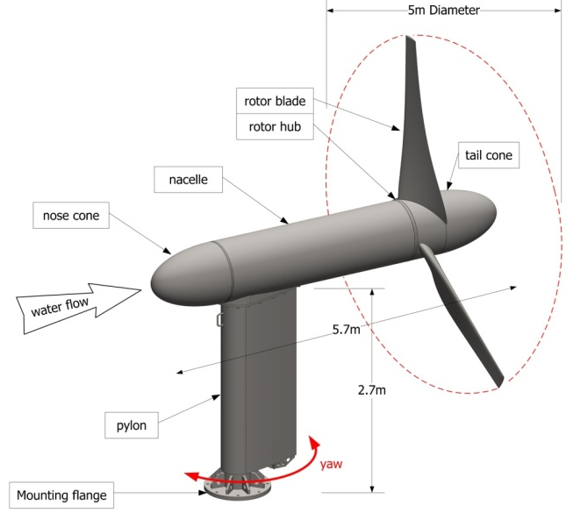
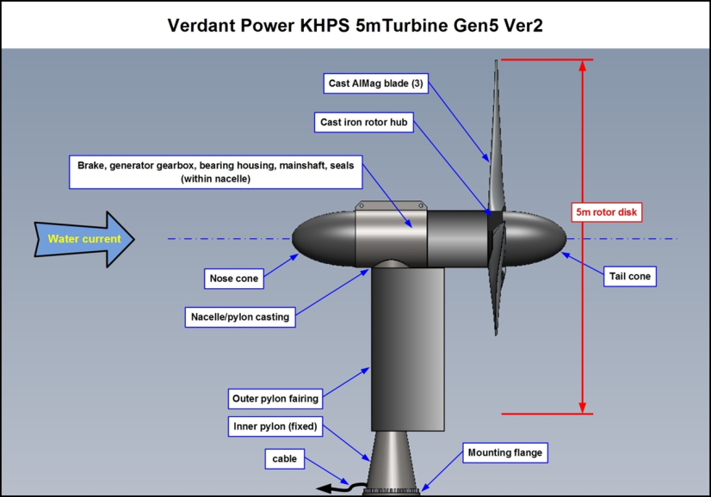
RITE Project - Phase 2
Lessons Learned & Applied
      Experience Gained in All Aspects of KHPS Installation & Operation
      Environmental Studies – Proportional to Fish Density & Possible Effects
      Rotor Structural Failures – Addressed in Fifth Generation (Gen5) Rotor Redesign
      Need More Extensive Advance Velocity Measurements & Turbulence Intensity
      Array Spacing & Siting Informed by Hydrodynamic & Generation Data

Slide 17
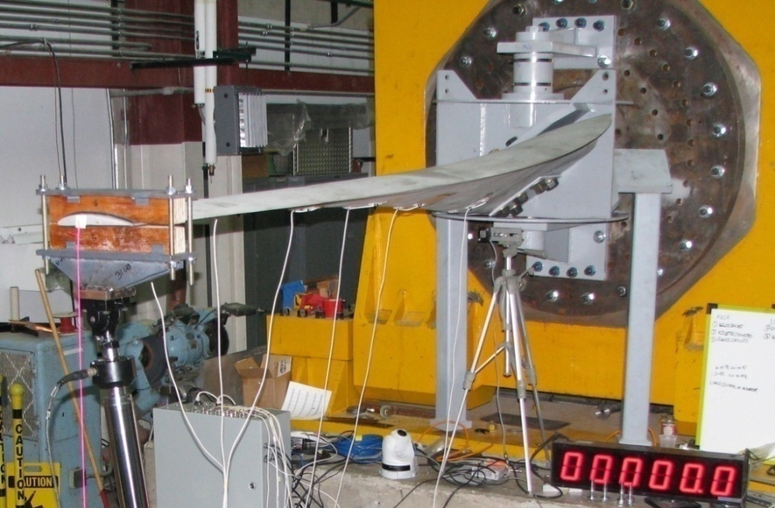
Fifth Generation (Gen5) Rotor Redesign
KHPS Blade Tested to 7 m/s & Beyond

Slide 18
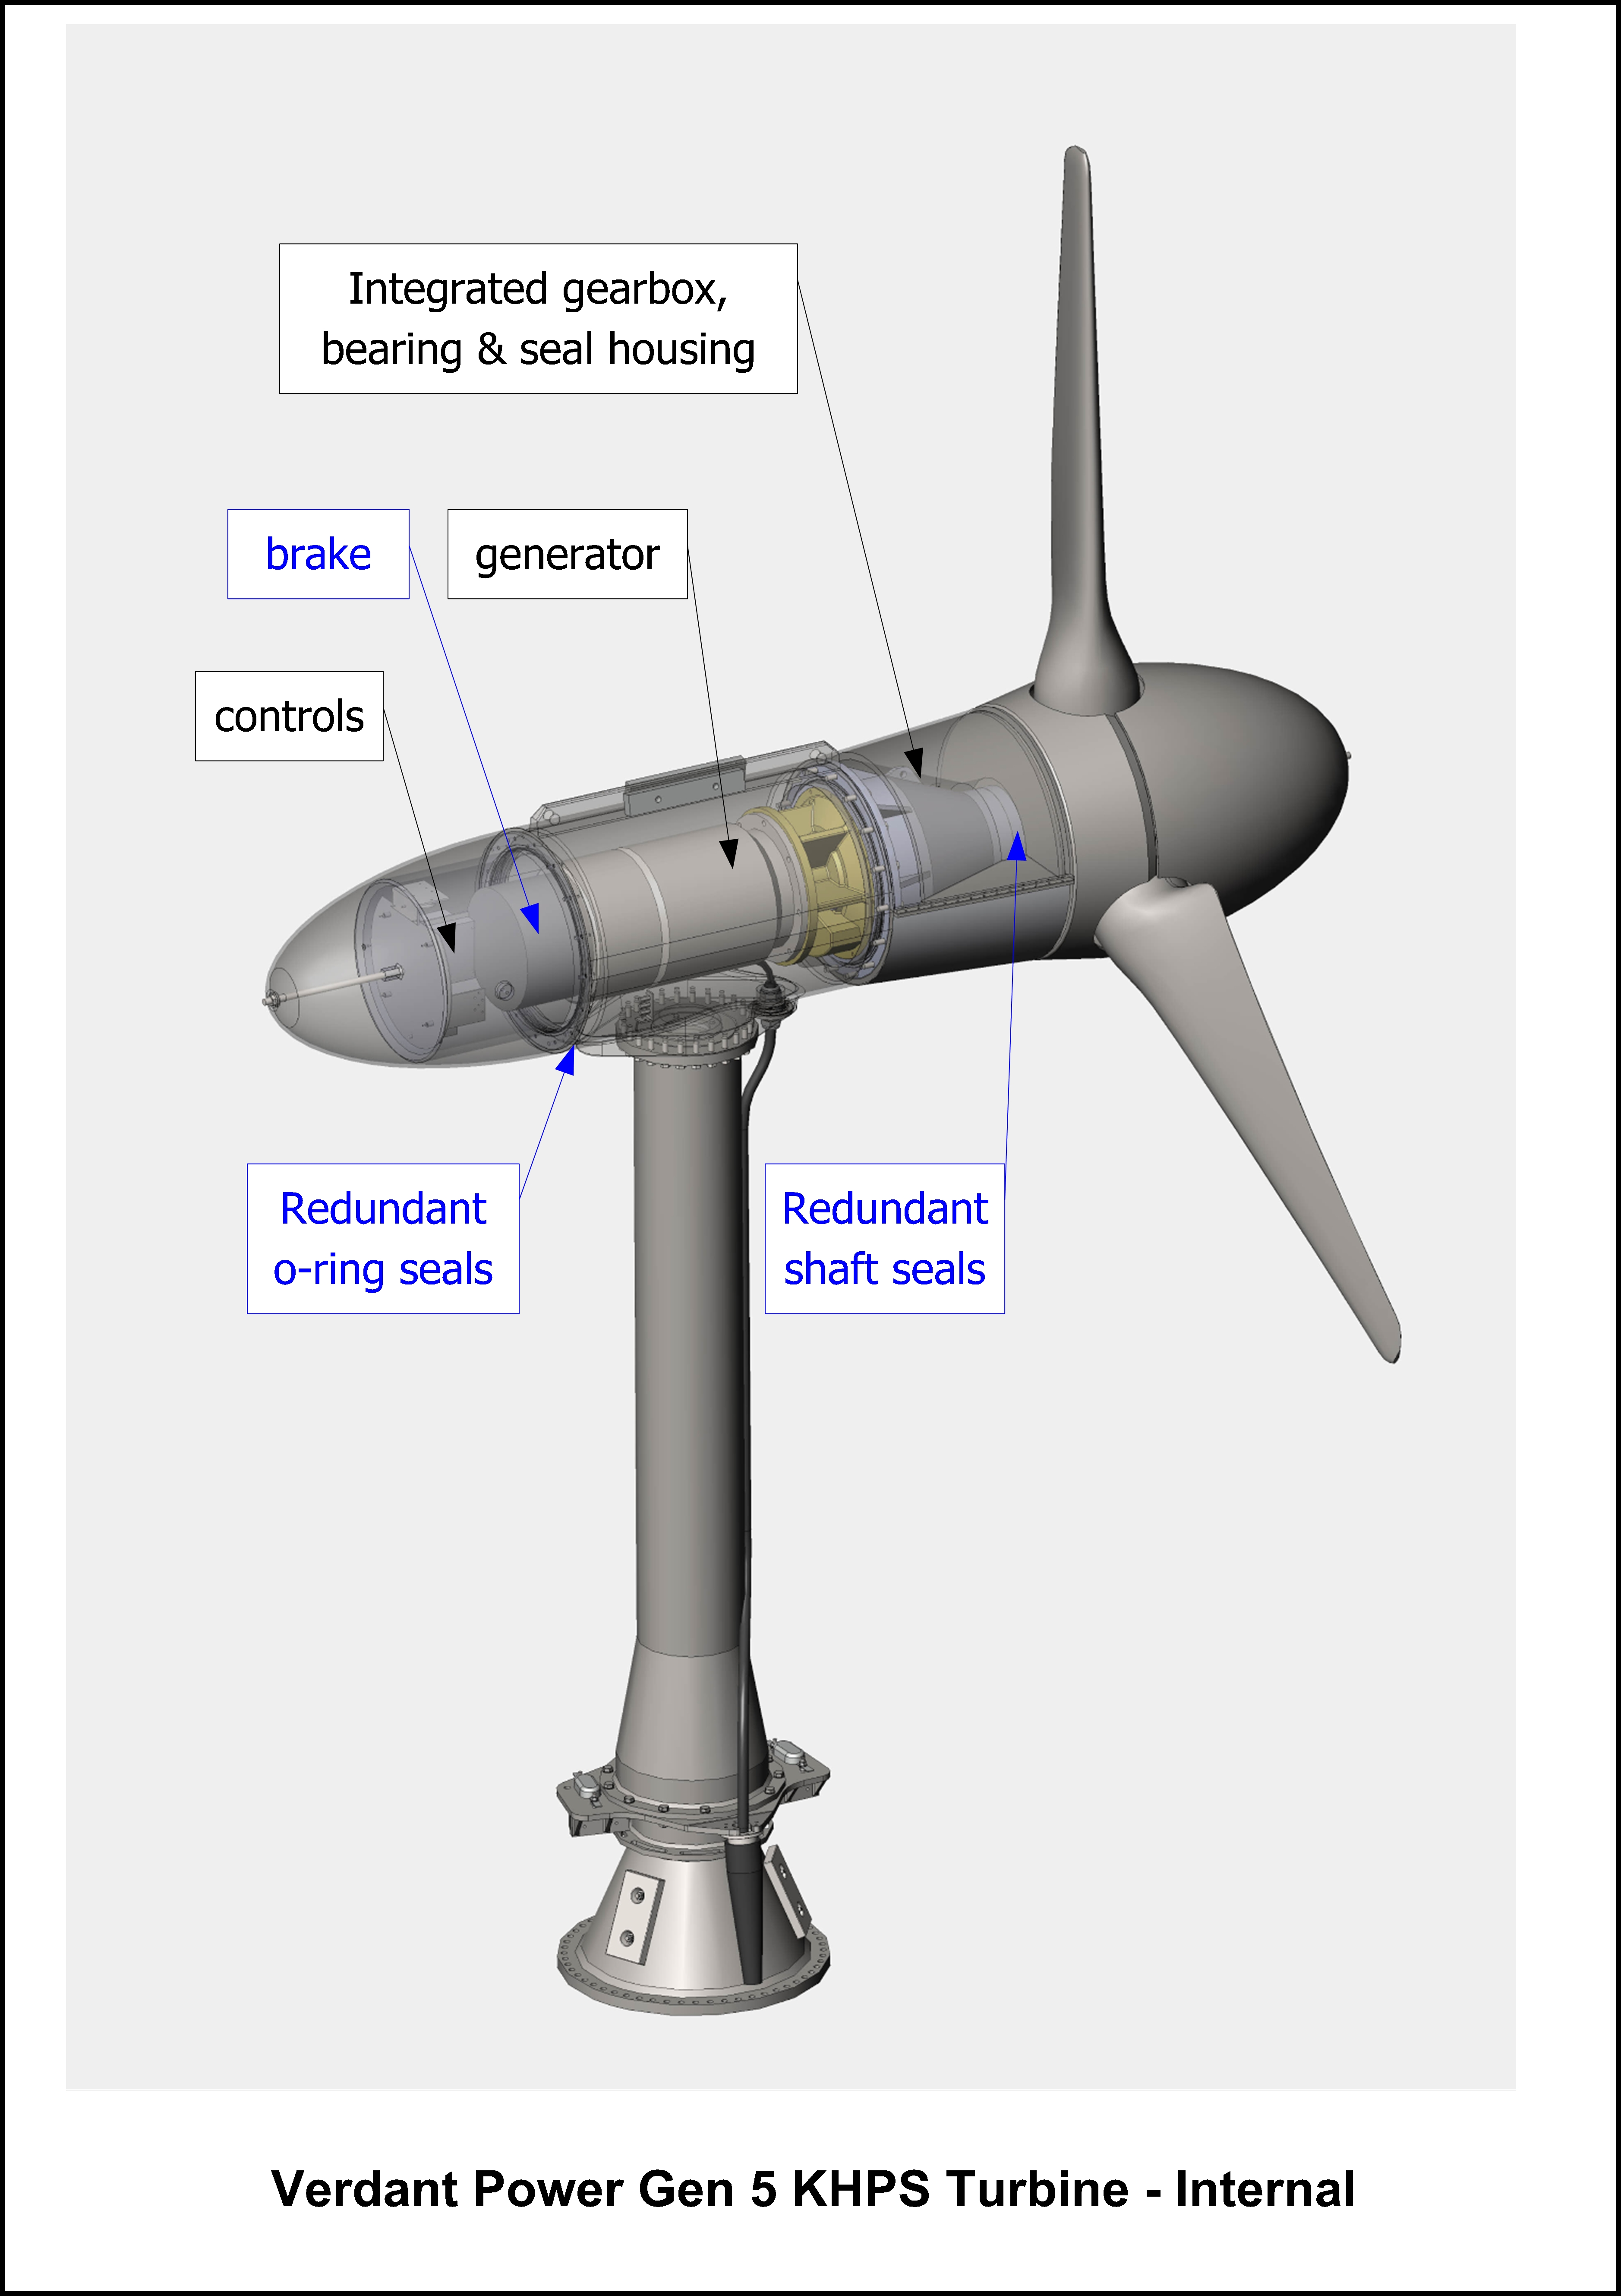
Verdant Power Today
Verdant Power Today
Gen5 5m Kinetic Hydropower System (KHPS)
  5m KHPS In manufacture; blades; gearboxes; QMS
  Composite blade testing at NREL
  Significant improvements from Gen4 design
Roosevelt Island Tidal Energy (RITE) Project
  Commercial license Jan 2012; 1MW (30 turbines)
  2012-2013 Gen5 testing and initial operation
  Environmental monitoring ( RMEE)
Gen5 10m class KHPS
  Scale-up from 56kW to 470kW
  Design and prototype testing cycle underway
Project Development
  Tidal Sites: Canada; UK; Asia
  River Sites: Canada; CORE (demonstration)

Slide 19
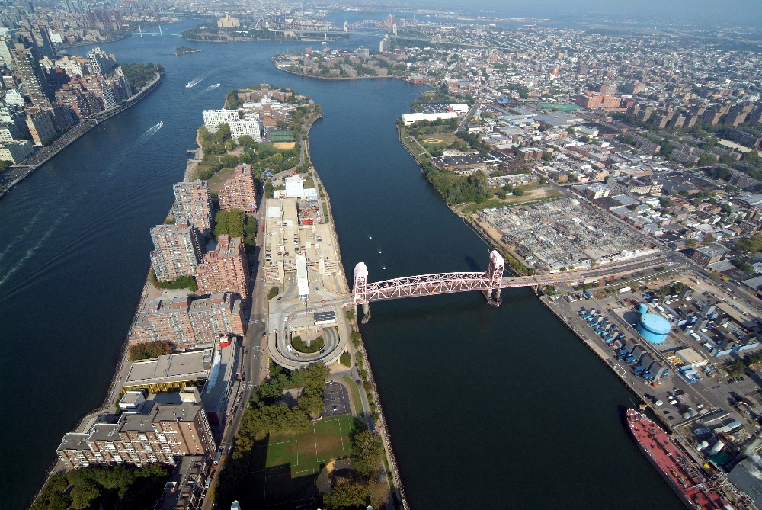
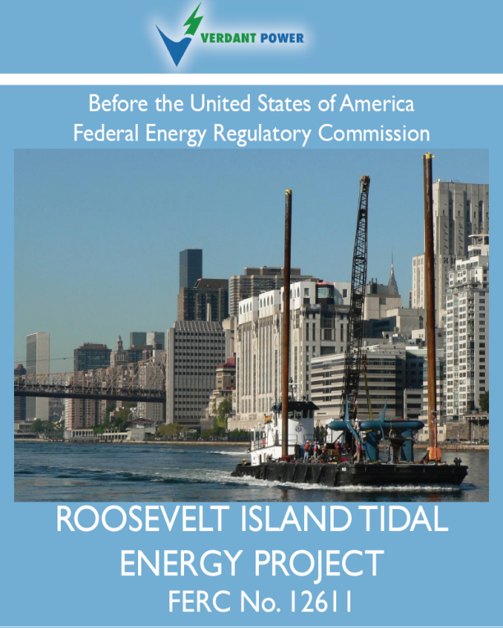
Roosevelt Island Tidal Energy (RITE) Project
FERC Pilot License Issued
FERC P-12611
Jan 23, 2012
www.theriteproject.com
Notes:
This is a picture of the site from above the lower end of Manhattan.
You can see the U.N. in the bottom of the screen …
… and a tug and barge about to enter the Western channel from the South.
our power field will be in the Eastern channel, beginning just north of the Queensboro Bridge.

Slide 20
FERC Pilot License Eligibility
(1) small; RITE project is 1.05 MW
(2) short term; License term is 10 years
(3) located in an environmentally non-sensitive area; RITE EA conducted shows likely no effects– but includes a $2.3M monitoring plan
(4) removable and able to be shut down on short notice; RITE will follow “adaptive management” if effects are observed
(5) removed, with the site restored, before the end of the license term unless the licensee obtains a new license; Opportunity for extension beyond 10-years and
(6) initiated by a draft application with appropriate environmental analysis; RITE analysis process was 2006-2012; 6 years.

Slide 21
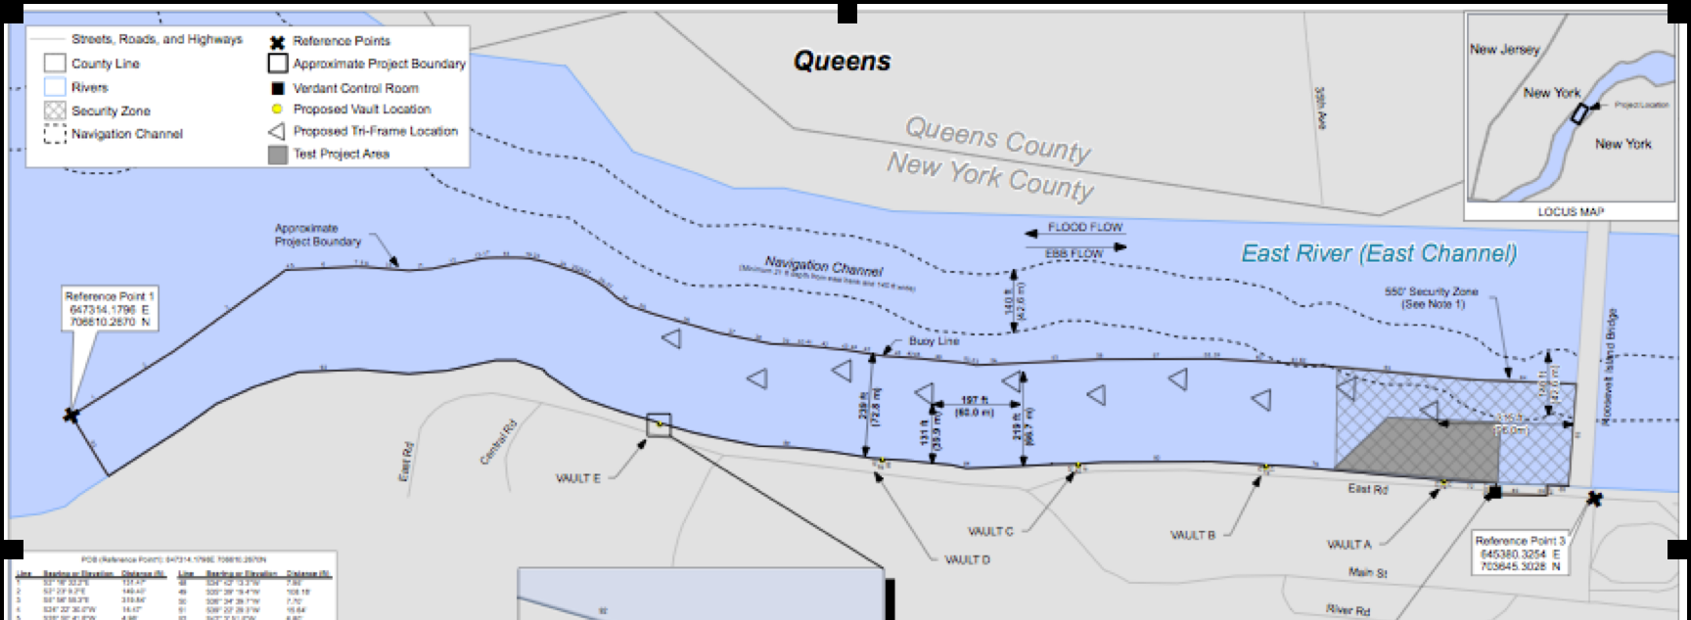
RITE Project - Phase 3 (2012-14)
1 MW = 10, Gen5, 5-m Class Triframes
“Six-Pack” Demo: 6 Turbines ~ 1.6 Acres
Commercial Project: 30, 5-m/35kW Turbines (10 Triframes) ~ 18 Acres
U.S. Federal Energy Regulatory Commission (FERC)
Recommends Pilot Commercial License to be Issued 2011

Slide 22
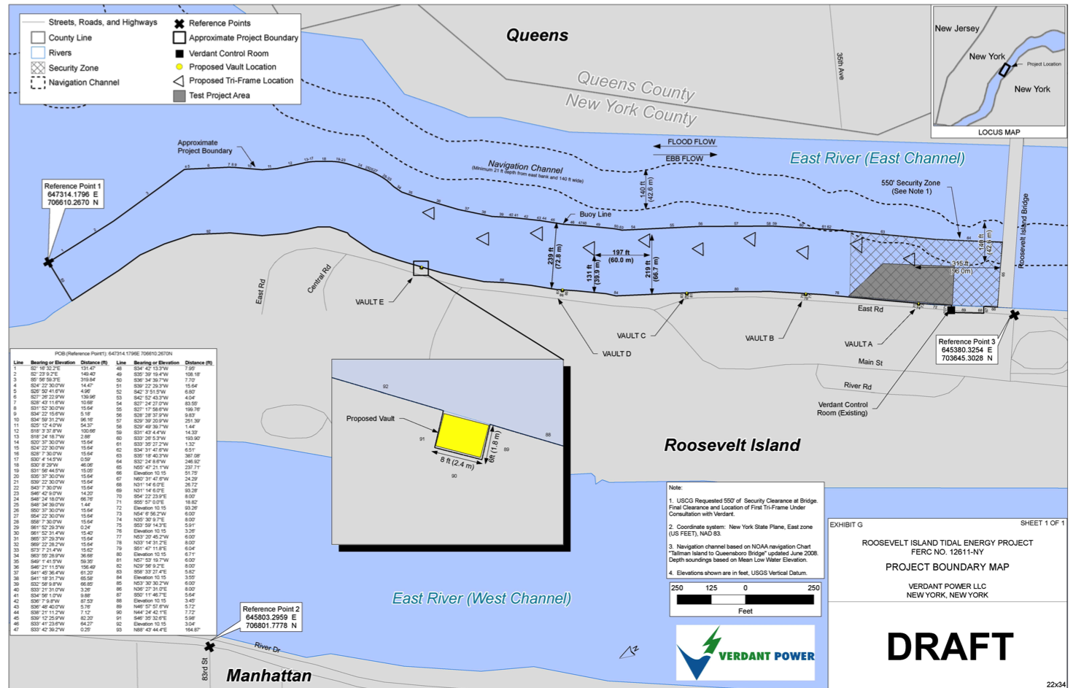
RITE Pilot Project
30 Turbine Array – Flow Scales
MESO SCALE
Through/around the turbine array
MICRO SCALE
Around one turbine
MACRO SCALE
Around the greater array region
11

Slide 23
RITE Project
3 Keys to Success
Ongoing Reliability and Longevity
  Generate Clean Renewable Energy – Gen5 will be Better
  High Water-Wire Efficiency and Capacity Factor
  Lessons Learned at RITE – Applicable to Commercial Build-Out
Improving Cost Effectiveness
  Advanced Computational Tools – Partnerships
  Gen5 Improvements – Less Parts & Sealing Improved
  Mounting – Move from Monopile to Tri-frame
Monitoring Environmental Compatibility
  RITE Demo Project Invaluable for Understanding Technology Interactions
  Improving on Understanding Fishery Interactions
  Specific Build-Out Monitoring Proposed
20

Slide 24
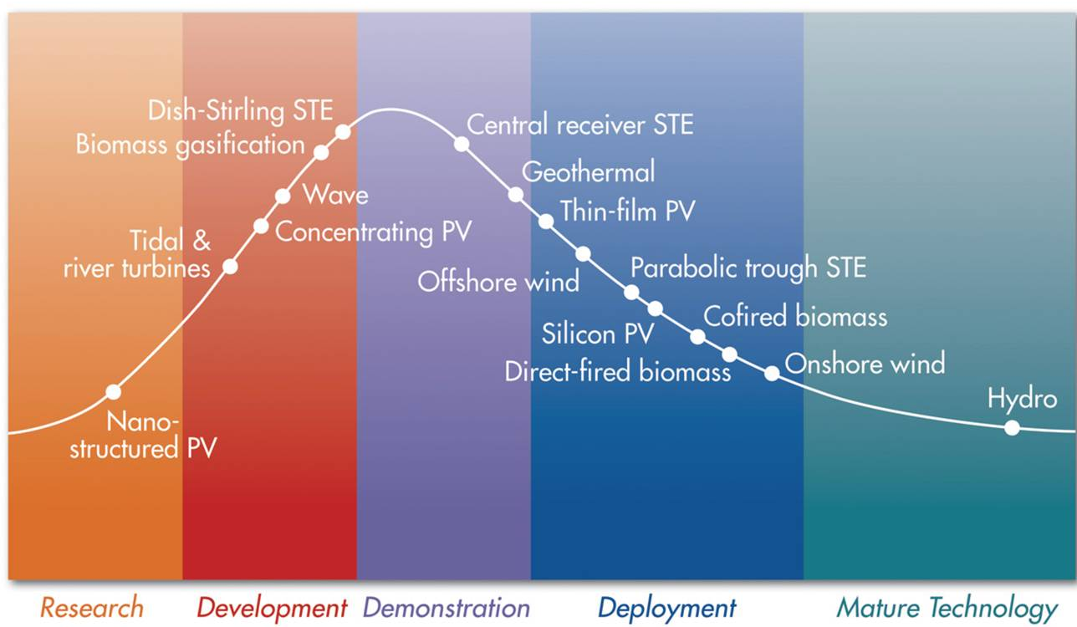
RITE Project
Economics
Verdant Power
COST
TIME
19

Slide 25
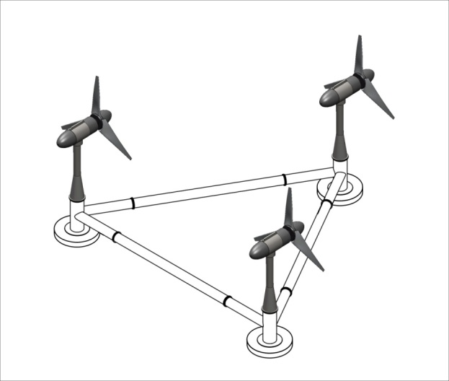
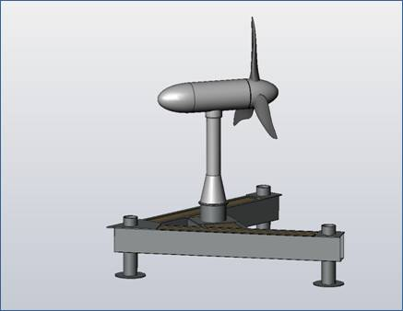
Gen5, Commercial Standard System
Tailored for Site, Using Triframes or Single Mounts
Deeper Water = Larger Rotor Diameter (m)
Faster Water (m/s) = Larger Generator (kW)
Rotor Size & Current Speed
Rotor | 2 m/s | 3m/s | 4m/s
5-m Class (5 to 7-m) | 28 kW | 95 | 224
7-m | 55 | 190 | 450
10-m Class (9 to 11-m) | 115 | 385 | 920
11-m | 138 | 470 | 1,110 kW

Slide 26
Generic MHK Project
Project Capital Costs / Expenditures (CapEx)
One (1) row of ten (10), Gen5, 10-m Class Triframes = 15 MW
  30 turbines – estimated CapEx: USD 2.4M per MW
Three (3) rows of ten (10), Gen5, 10-m Class Triframes = 50 MW
  90 turbines – estimated CapEx: USD 2.2M per MW
Five (5) rows of ten (10), Gen5, 10-m Class Triframes = 75 MW
  150 turbines – estimated CapEx: USD 2M per MW
Seven (7) rows of ten (10), Gen5, 10-m Class Triframes = 100 MW
  210 turbines – estimated CapEx: USD 1.8M per MW
Ten (10) rows of ten (10), Gen5, 10-m Class Triframes = 150 MW
  300 turbines – estimated CapEx: USD 1.5M per MW

Slide 27

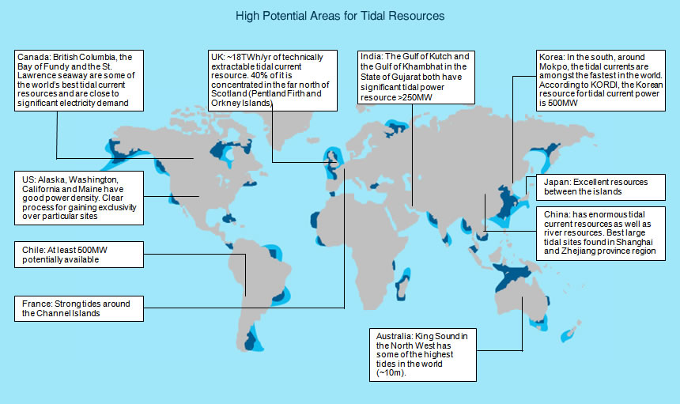
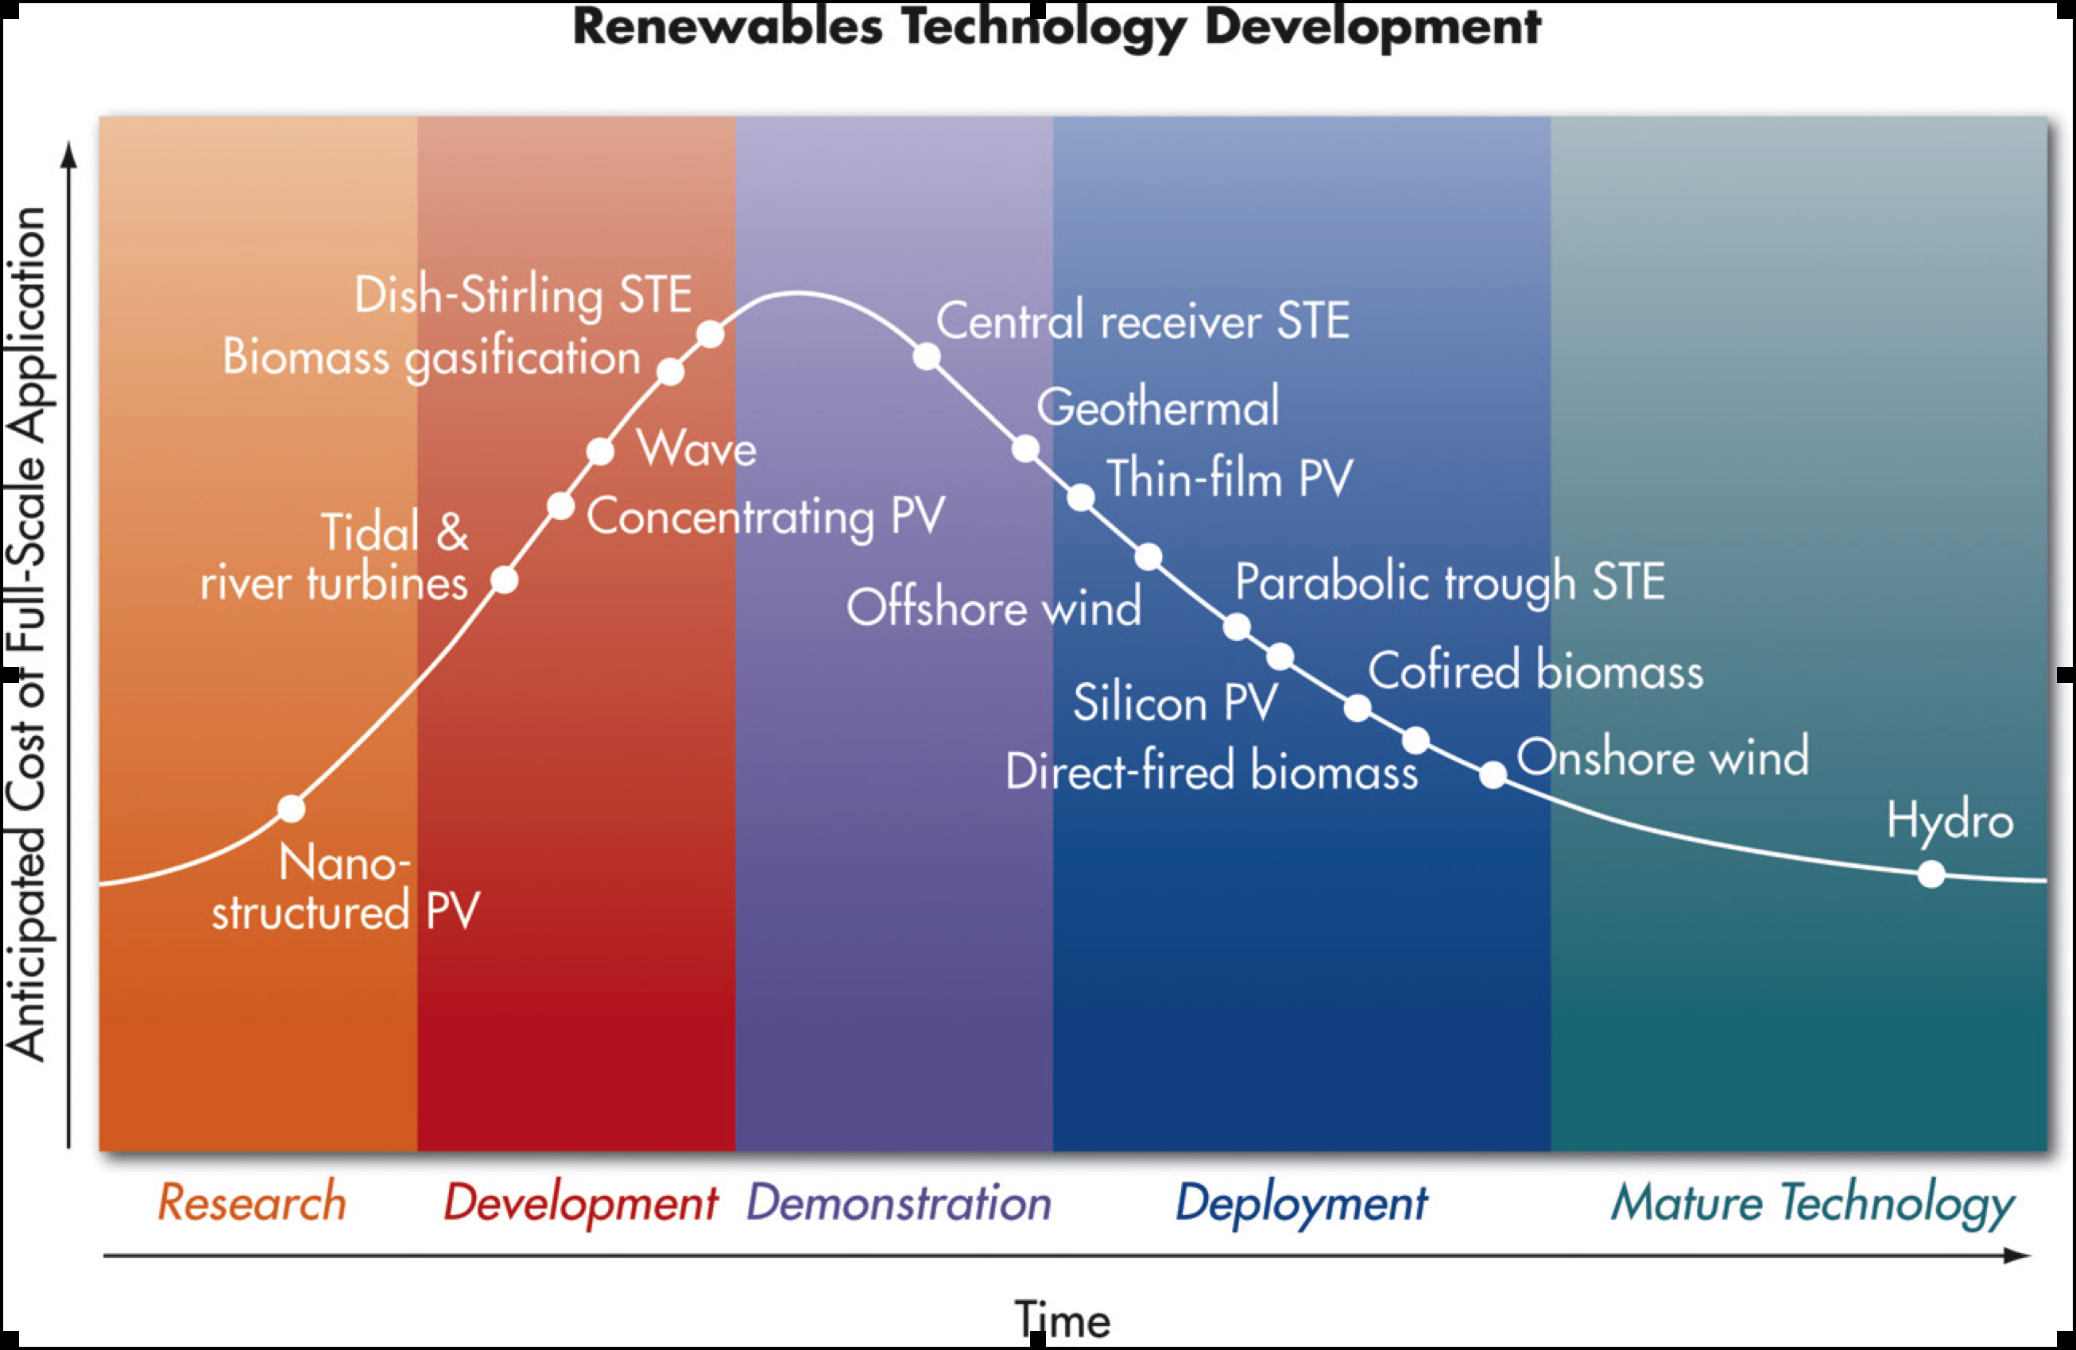
Moving forward - Opportunities
Desire for renewables
  Generation
  MHK industry = jobs
Significant resource
  Distributed generation
  Small and large pilot arrays
Kinetic Hydropower System works!
  High W-T-W efficiency
  Predictable; simplistic
  Environmentally compatible
Synergies with other renewables
  Co-location
  Cable/Trans/O&M efficiencies

Slide 28
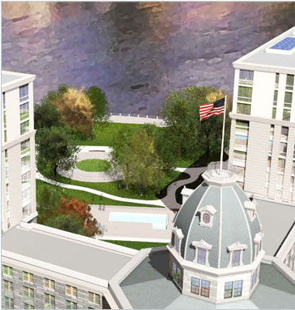
Contact Information
Ron Smith
Verdant Power, Inc
The Octagon
888 Main Street
New York, NY 10044
rsmith@verdantpower.com
www.verdantpower.com
www.theriteproject.com
USA: 212-888-8887 x601
The Octagon

